Slide 1
Participants: Gretchen Germann and Isabella Riffle
Chapter Name: Penta Career Center-ECE
School: Penta Career Center
City: Perrysburg
Event Name: Promote and Publicize
Project Title: Finding You within FCCLA

Slide 2
Evidence of Online Project Summary Sheet
EVIDENCE OF PROJECT SUMMARY SUBMISSION
Thank you for completing the project summary form for your STAR Event. To receive the point for submission, print this email and have your adviser verify by signing and dating below for including in a display, file folder, or portfolio. One survey per entry is required.
Chapter Name: Penta Career Center - ECE - 10250
State: Ohio
Members: Gretchen L Germann and Isabella K Riffle
Event Name: Promote and Publicize FCCLA!
Level: Level 3 (grades 11 and 12)
Project Title: Finding You within FCCLA
Adviser's Signature
Date

Slide 3
FCCLA Planning Process Summary Page
Identify Concerns | In the early weeks of becoming familiar with the Early Childhood Program at Penta Career Center we realized that not enough new chapter members, school and community were aware of what FCCLA is all about. This is a concern because our chapter strives to make FCCLA a large focus in our ECE lab and throughout our school.
Set A Goal | After identifying our concern we spoke with our mentors and then developed a goal to bring more awareness to FCCLA at Penta Career Center. The purpose of our goal is to inform our lab, school and community of the opportunities presented by FCCLA during the 2020-2021 academic school year.
Form A Plan | Who- Gretchen Germann and Isabella Riffle What- Promoting FCCLA in our chapter and school Where- Penta Career Center in the Early Childhood Lab When- August 2020-May 2021 How- By researching the history of FCCLA, FCCLA at Penta Career Center and distributing the knowledge found

Slide 4
FCCLA Planning Process Summary Page
Act | We thoroughly researched the background of National and Ohio FCCLA. We then created bulletin boards throughout our school, informed others though speeches and volunteer opportunities and distributed FCCLA themed items, following our yearly plan.
Follow Up | Overall we enjoyed the project. We learned a lot about National and Ohio FCCLA. We feel as though we were able to actively promote FCCLA in exciting and eventful ways to our chapter members, school and community. Evaluating our goals showed that 100% of our classmates became involved, understood, and participated in learning more about FCCLA. We did have to change up how we went about some of our projects and activities due to Covid and protocols at our school.

Slide 5
Table of Contents
Slide 1: Project Identification Page
Slide 2: Evidence of Online Project Summary Sheet
Slide 3-4: FCCLA Planning Process Summary Page
Slides 5: Table of Contents
Slides 6-9: Evidence of Research
Slides 10-13: Promotion Plan Description
Slides 14-19: Evidence of Campaign
Slides 20-22: Technology Used
Slides 23-25: Evidence of Public Awareness and Promotion
Slides 26-29: Relationship to Family and Consumer Science
Slides 30-31: Work Cited

Slide 6
Evidence of Research

Slide 7
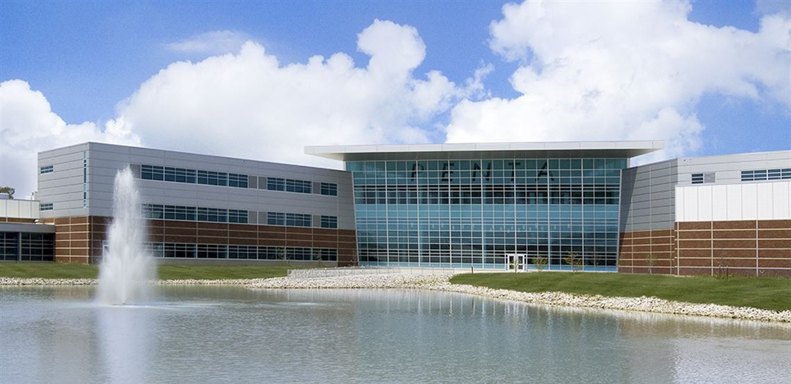
Chapter History
Penta Career Center is the oldest career center in the state of Ohio, opening in 1965.
Today, Penta serves the same 5 counties as it did 52 years ago. As we researched FCCLA at Penta Career Center we found that the number of individuals involved has grown throughout the years.
In early years, FCCLA at Penta was known as Hero; which is the acronym for Home Economics Related Occupations.
In 2003 as Penta feeder schools where closing FCS programs, Penta picked them up as satellite programs. These programs were required to have FCCLA chapters.

Slide 8
Ohio FCCLA History
Ohio FCCLA charter was granted on January 14, 1946
This year 2021 Ohio is celebrating its “75th FCCLA Birthday”
Ohio has 7,500 affiliated middle school and high school students and is the 6th largest delegation in the nation

Slide 9
National FCCLA History
Over 160,000 members in more than 5,300 chapters are active in a network of associations in 49 states, in addition to the Virgin Islands and Puerto Rico.
FCCLA has 8 peer-to-peer educational programs
32 Star Events
Involvement Opportunities

Slide 10
Promotion Plan Description

Slide 11
Current year Goal and Objective
Goal
After identifying our concern we spoke with our mentors and then developed a goal to bring more awareness to FCCLA at Penta Career Center. The purpose of our goal is to inform our lab, school and community of the opportunities presented by FCCLA during the 2020-2021 academic school year.
Objective
Being a chapter that already has 100% affiliation, our overall goal was to have all of our classmates actively participate in monthly campaign activities to gain a more clear understanding of FCCLA.

Slide 12
Current year plans
September:
The start of our project- How can we promote FCCLA?
Creation of FCCLA bitmoji classroom which we added to our ECE Unified Classroom class pages.

Slide 13
Current year plans
November:
Made our FCCLA masks with chapter members
Had our class create a button design
FCCLA week activities
Attended an ECE Advisory meeting to talk about and promote FCCLA
December:
Ran a food drive for the Penta Pantry
ECE FCCLA Christmas projects
January:
Put Promote and Publicize materials together for competition
October:
Designed and created promotional FCCLA bulletin boards
Attended a Tri-State Leadership Conference
Created papers for our FCCLA Button Contest
Purchased materials to make our FCCLA Masks

Slide 14
Evidence of Campaign

Slide 15
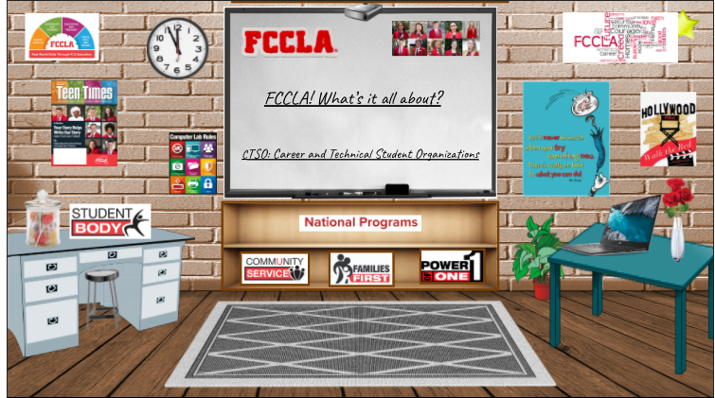
Fccla awareness throughout our school community
Bitmoji for Powerschool Unified Classroom
https://docs.google.com/presentation/d/1q_O5xqU9qIy6nWoCxhIatq7kQz59AsOZW3Gof2n5YHM/edit#slide=id.g9a8c7dd1dd_0_0

Slide 16
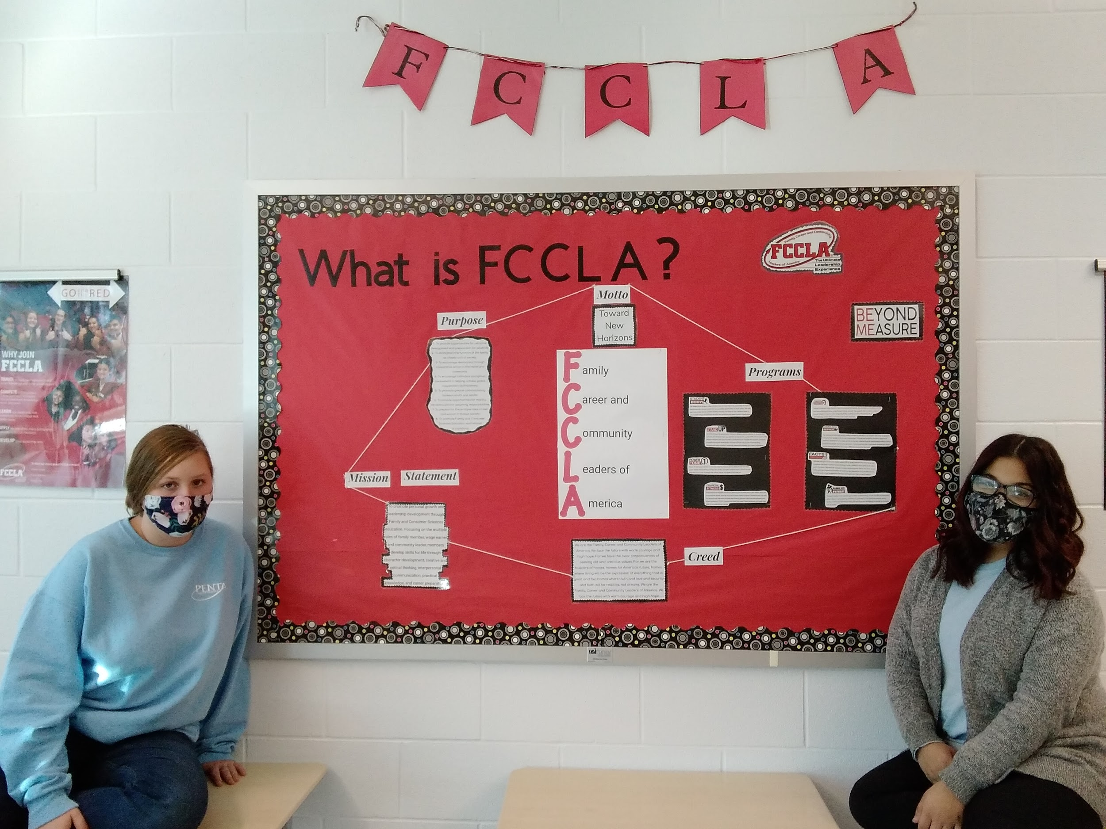
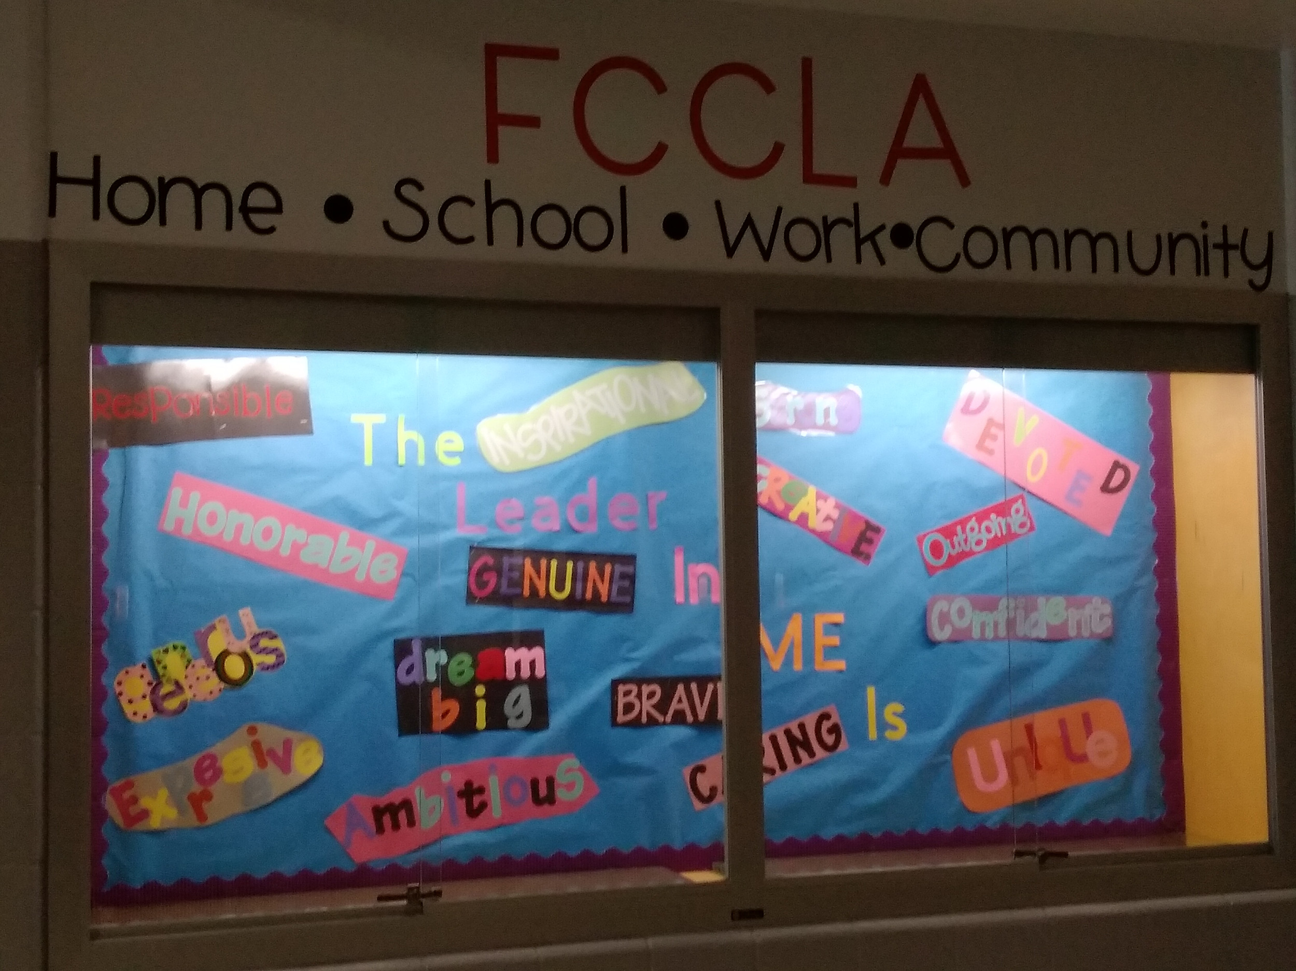
Publicity about Chapter Events
Bulletin Boards

Slide 17
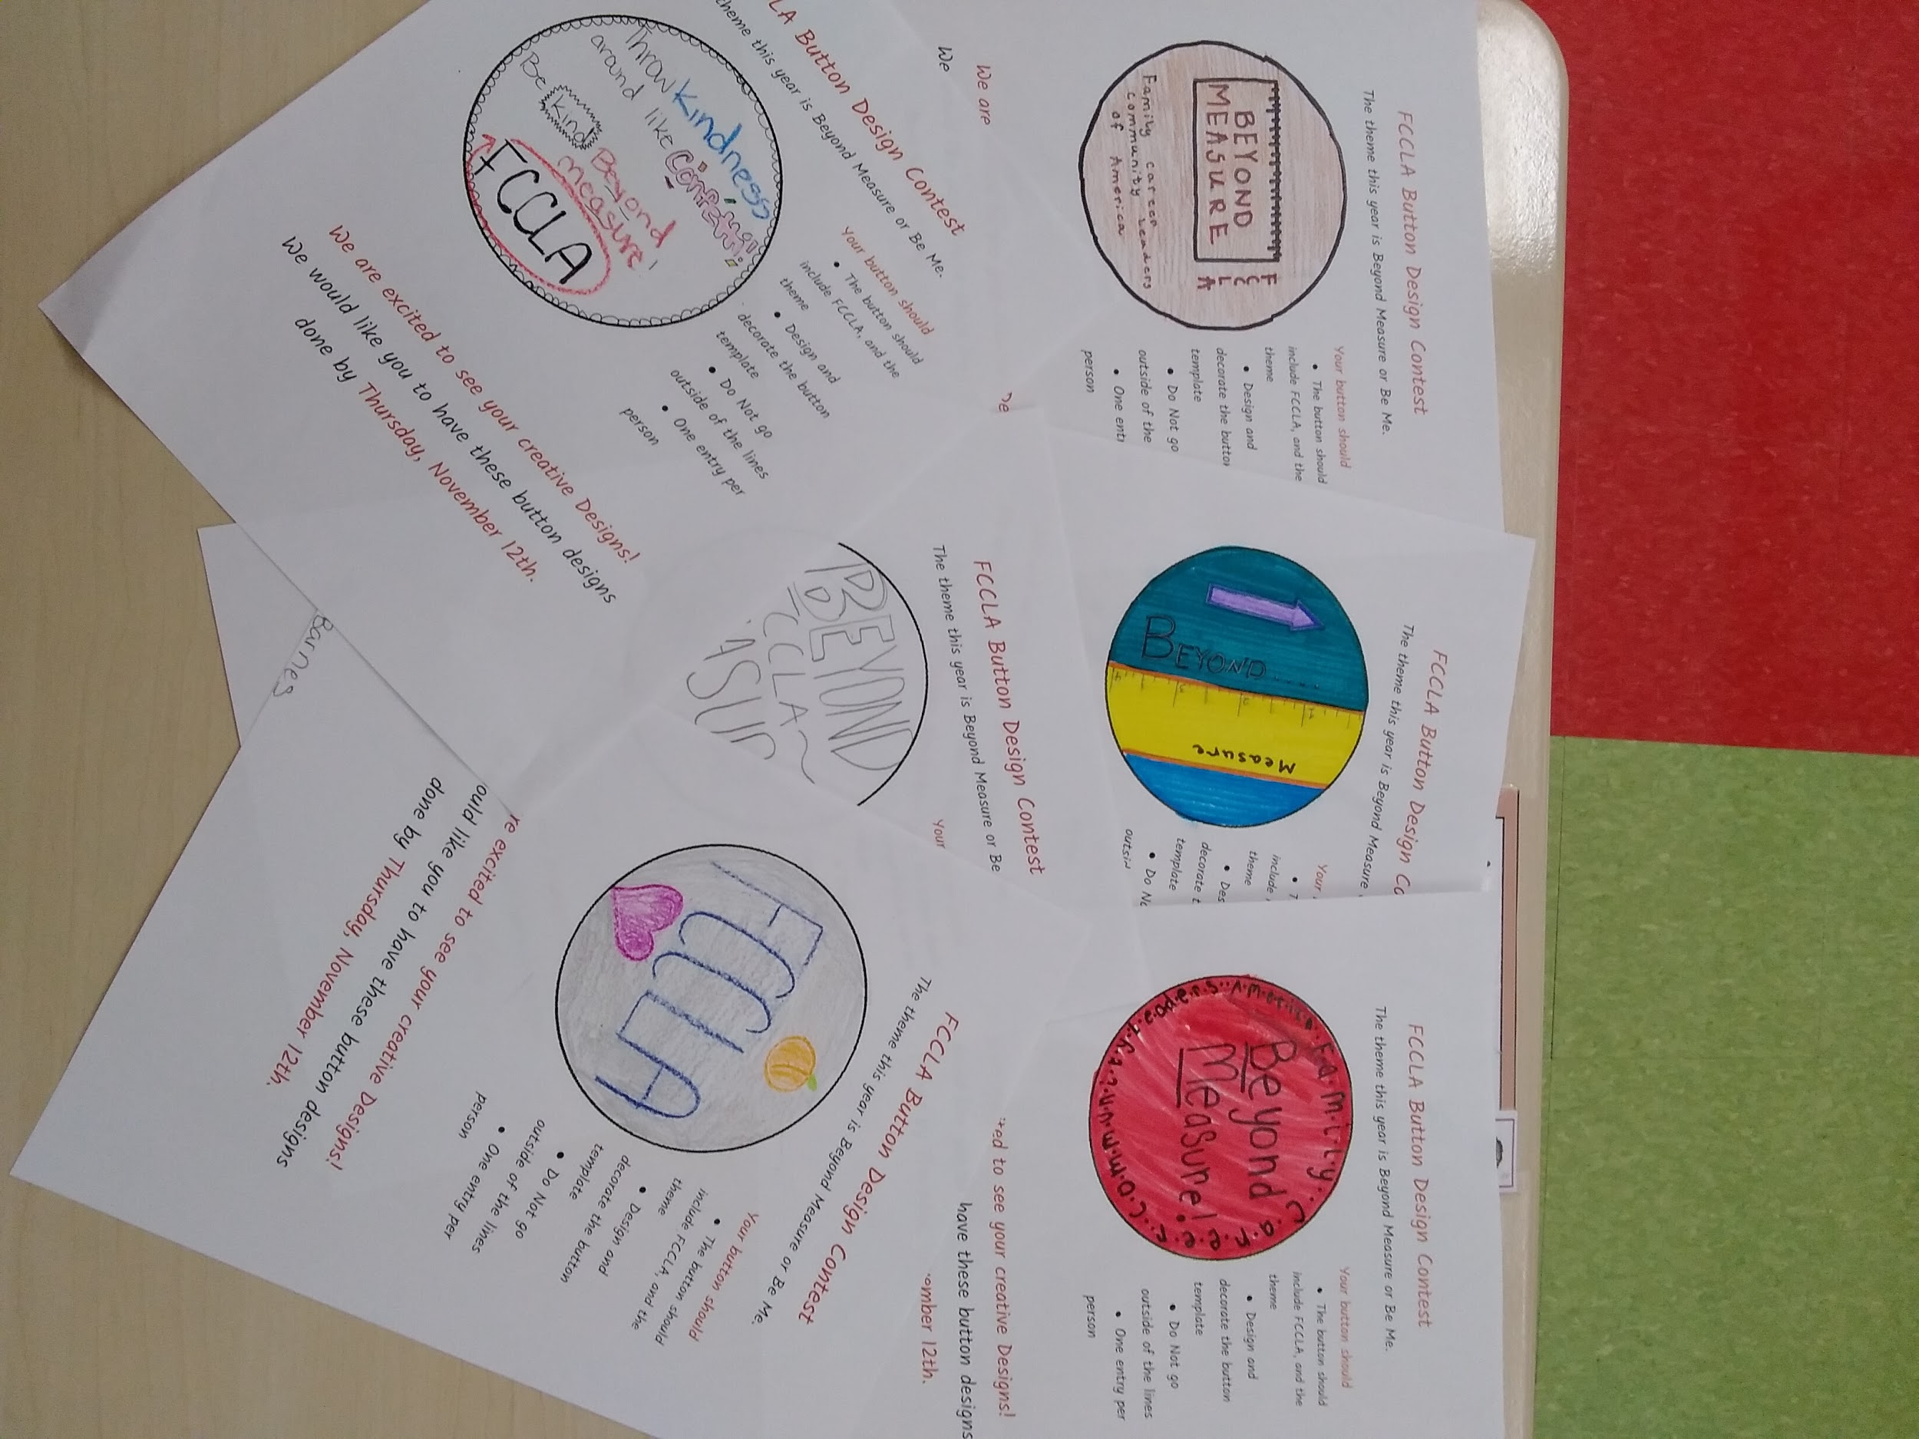
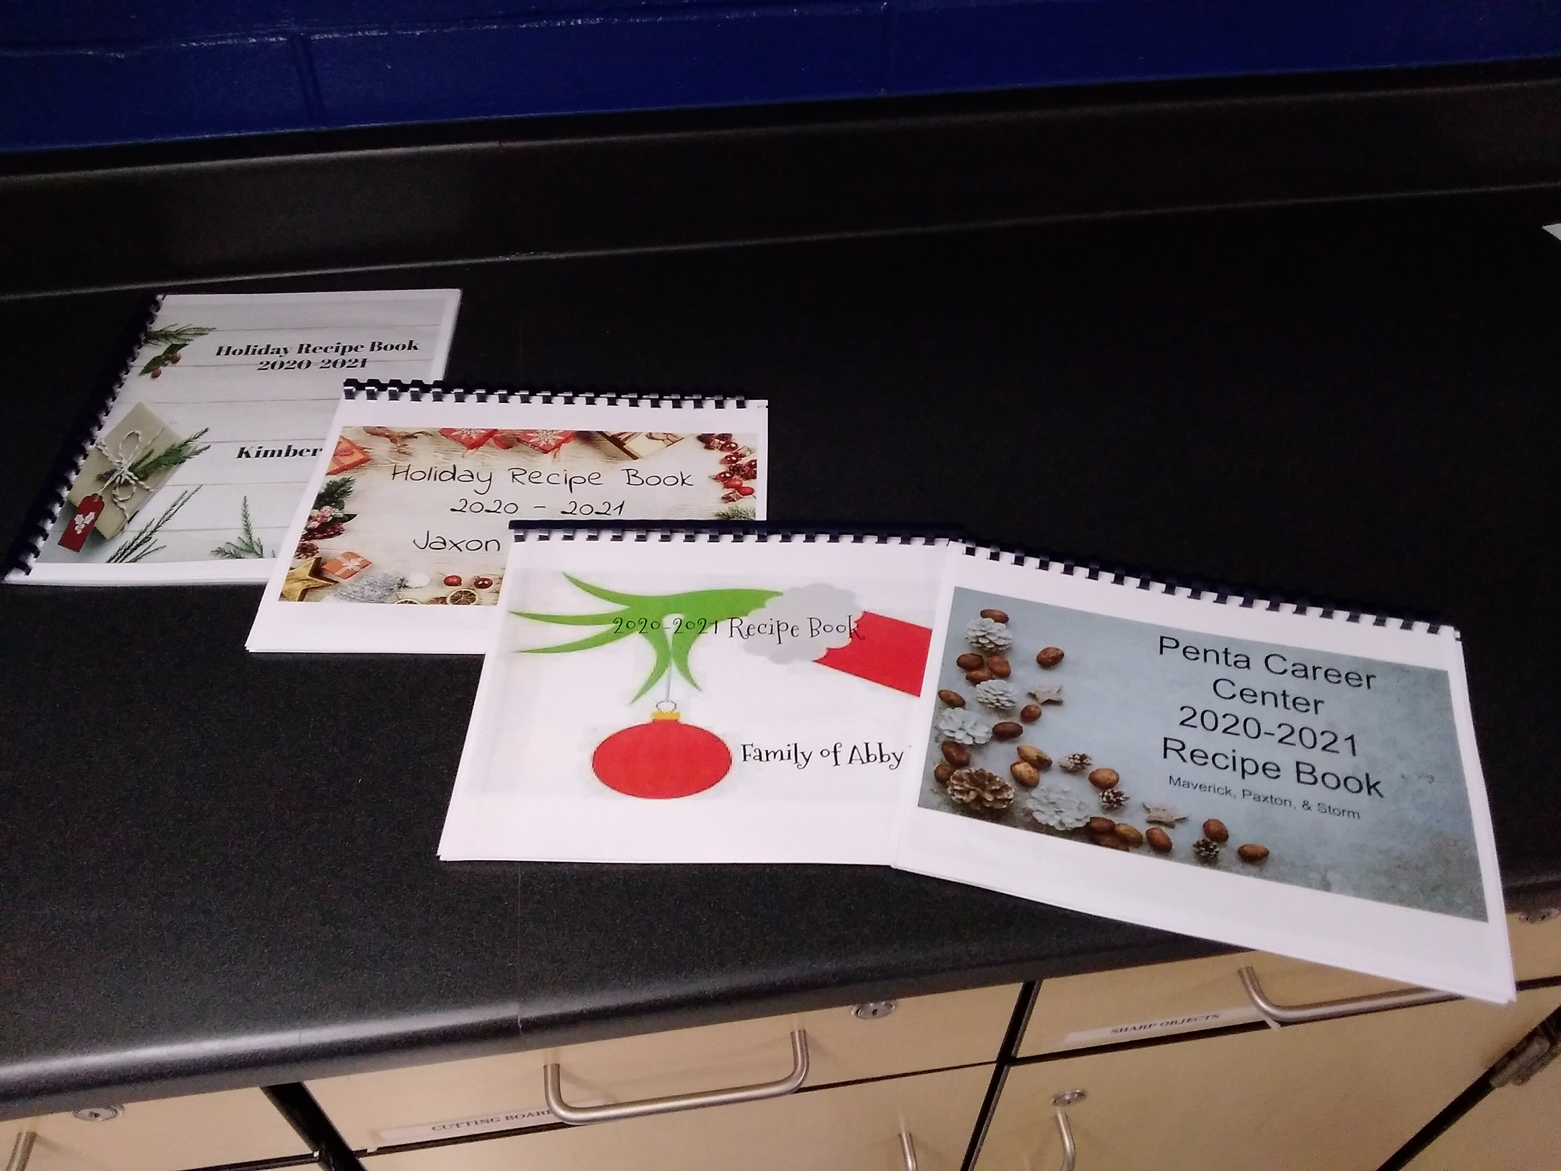
Publicity about Chapter Events
Buttons and Christmas Projects

Slide 18
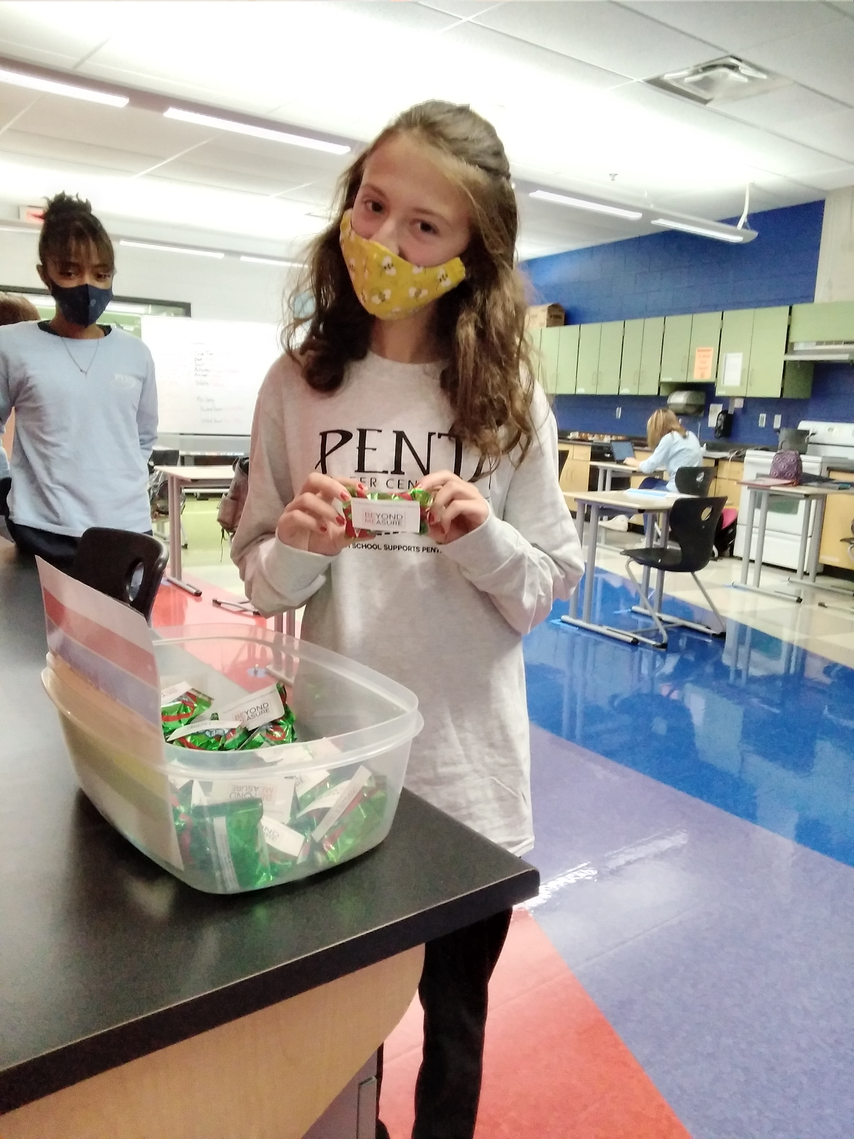
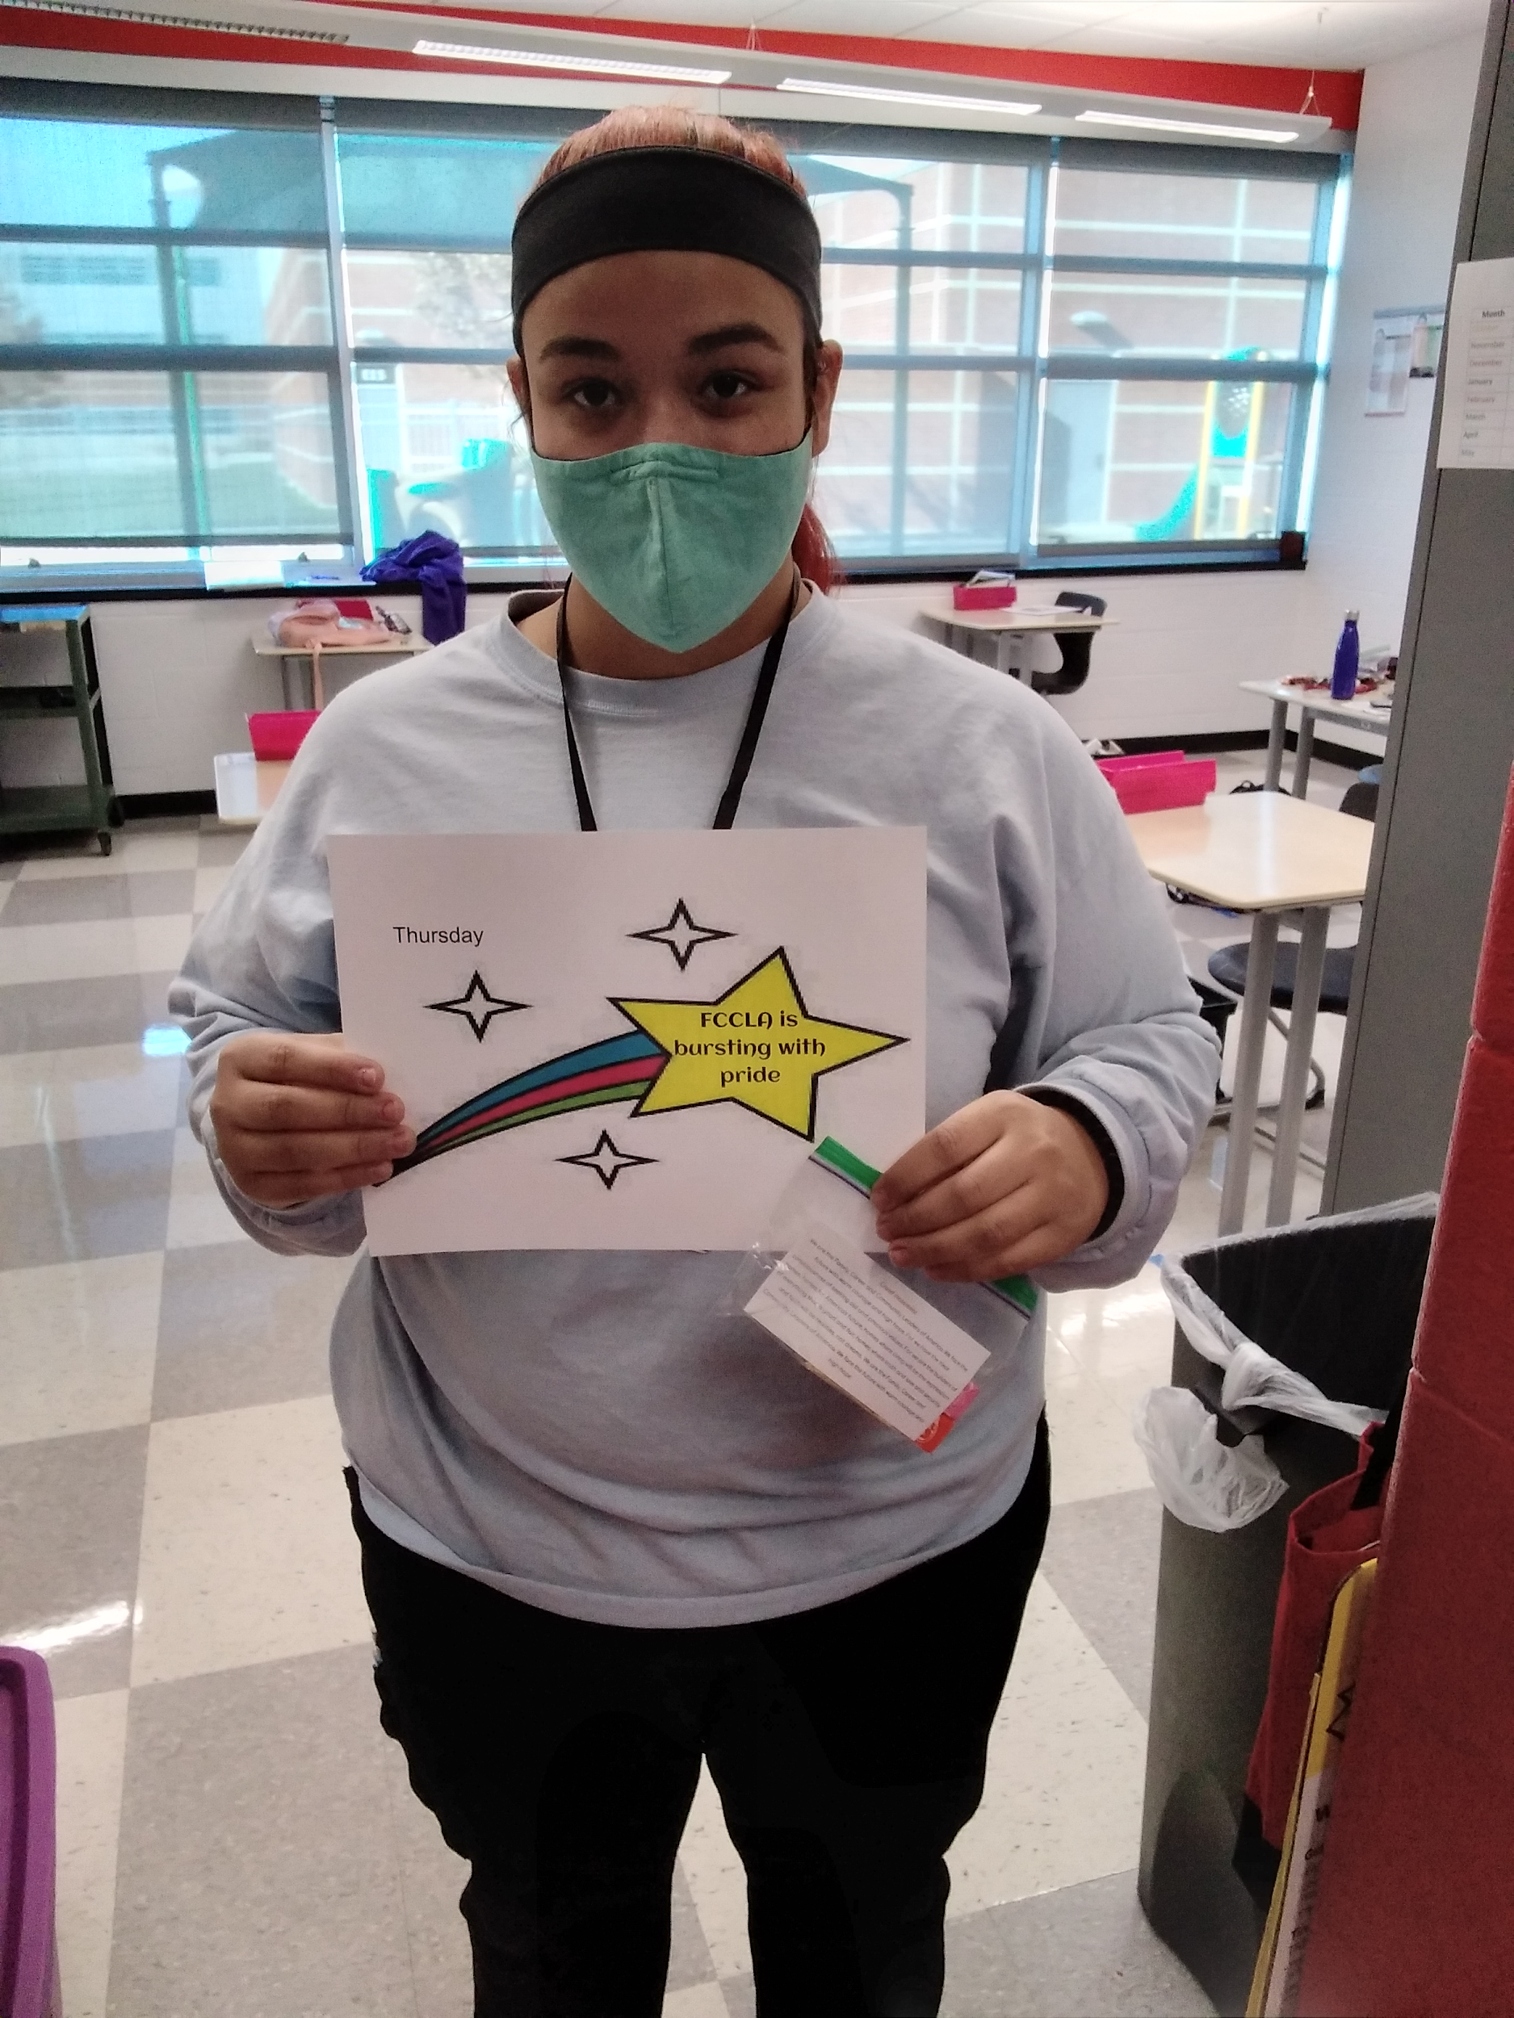
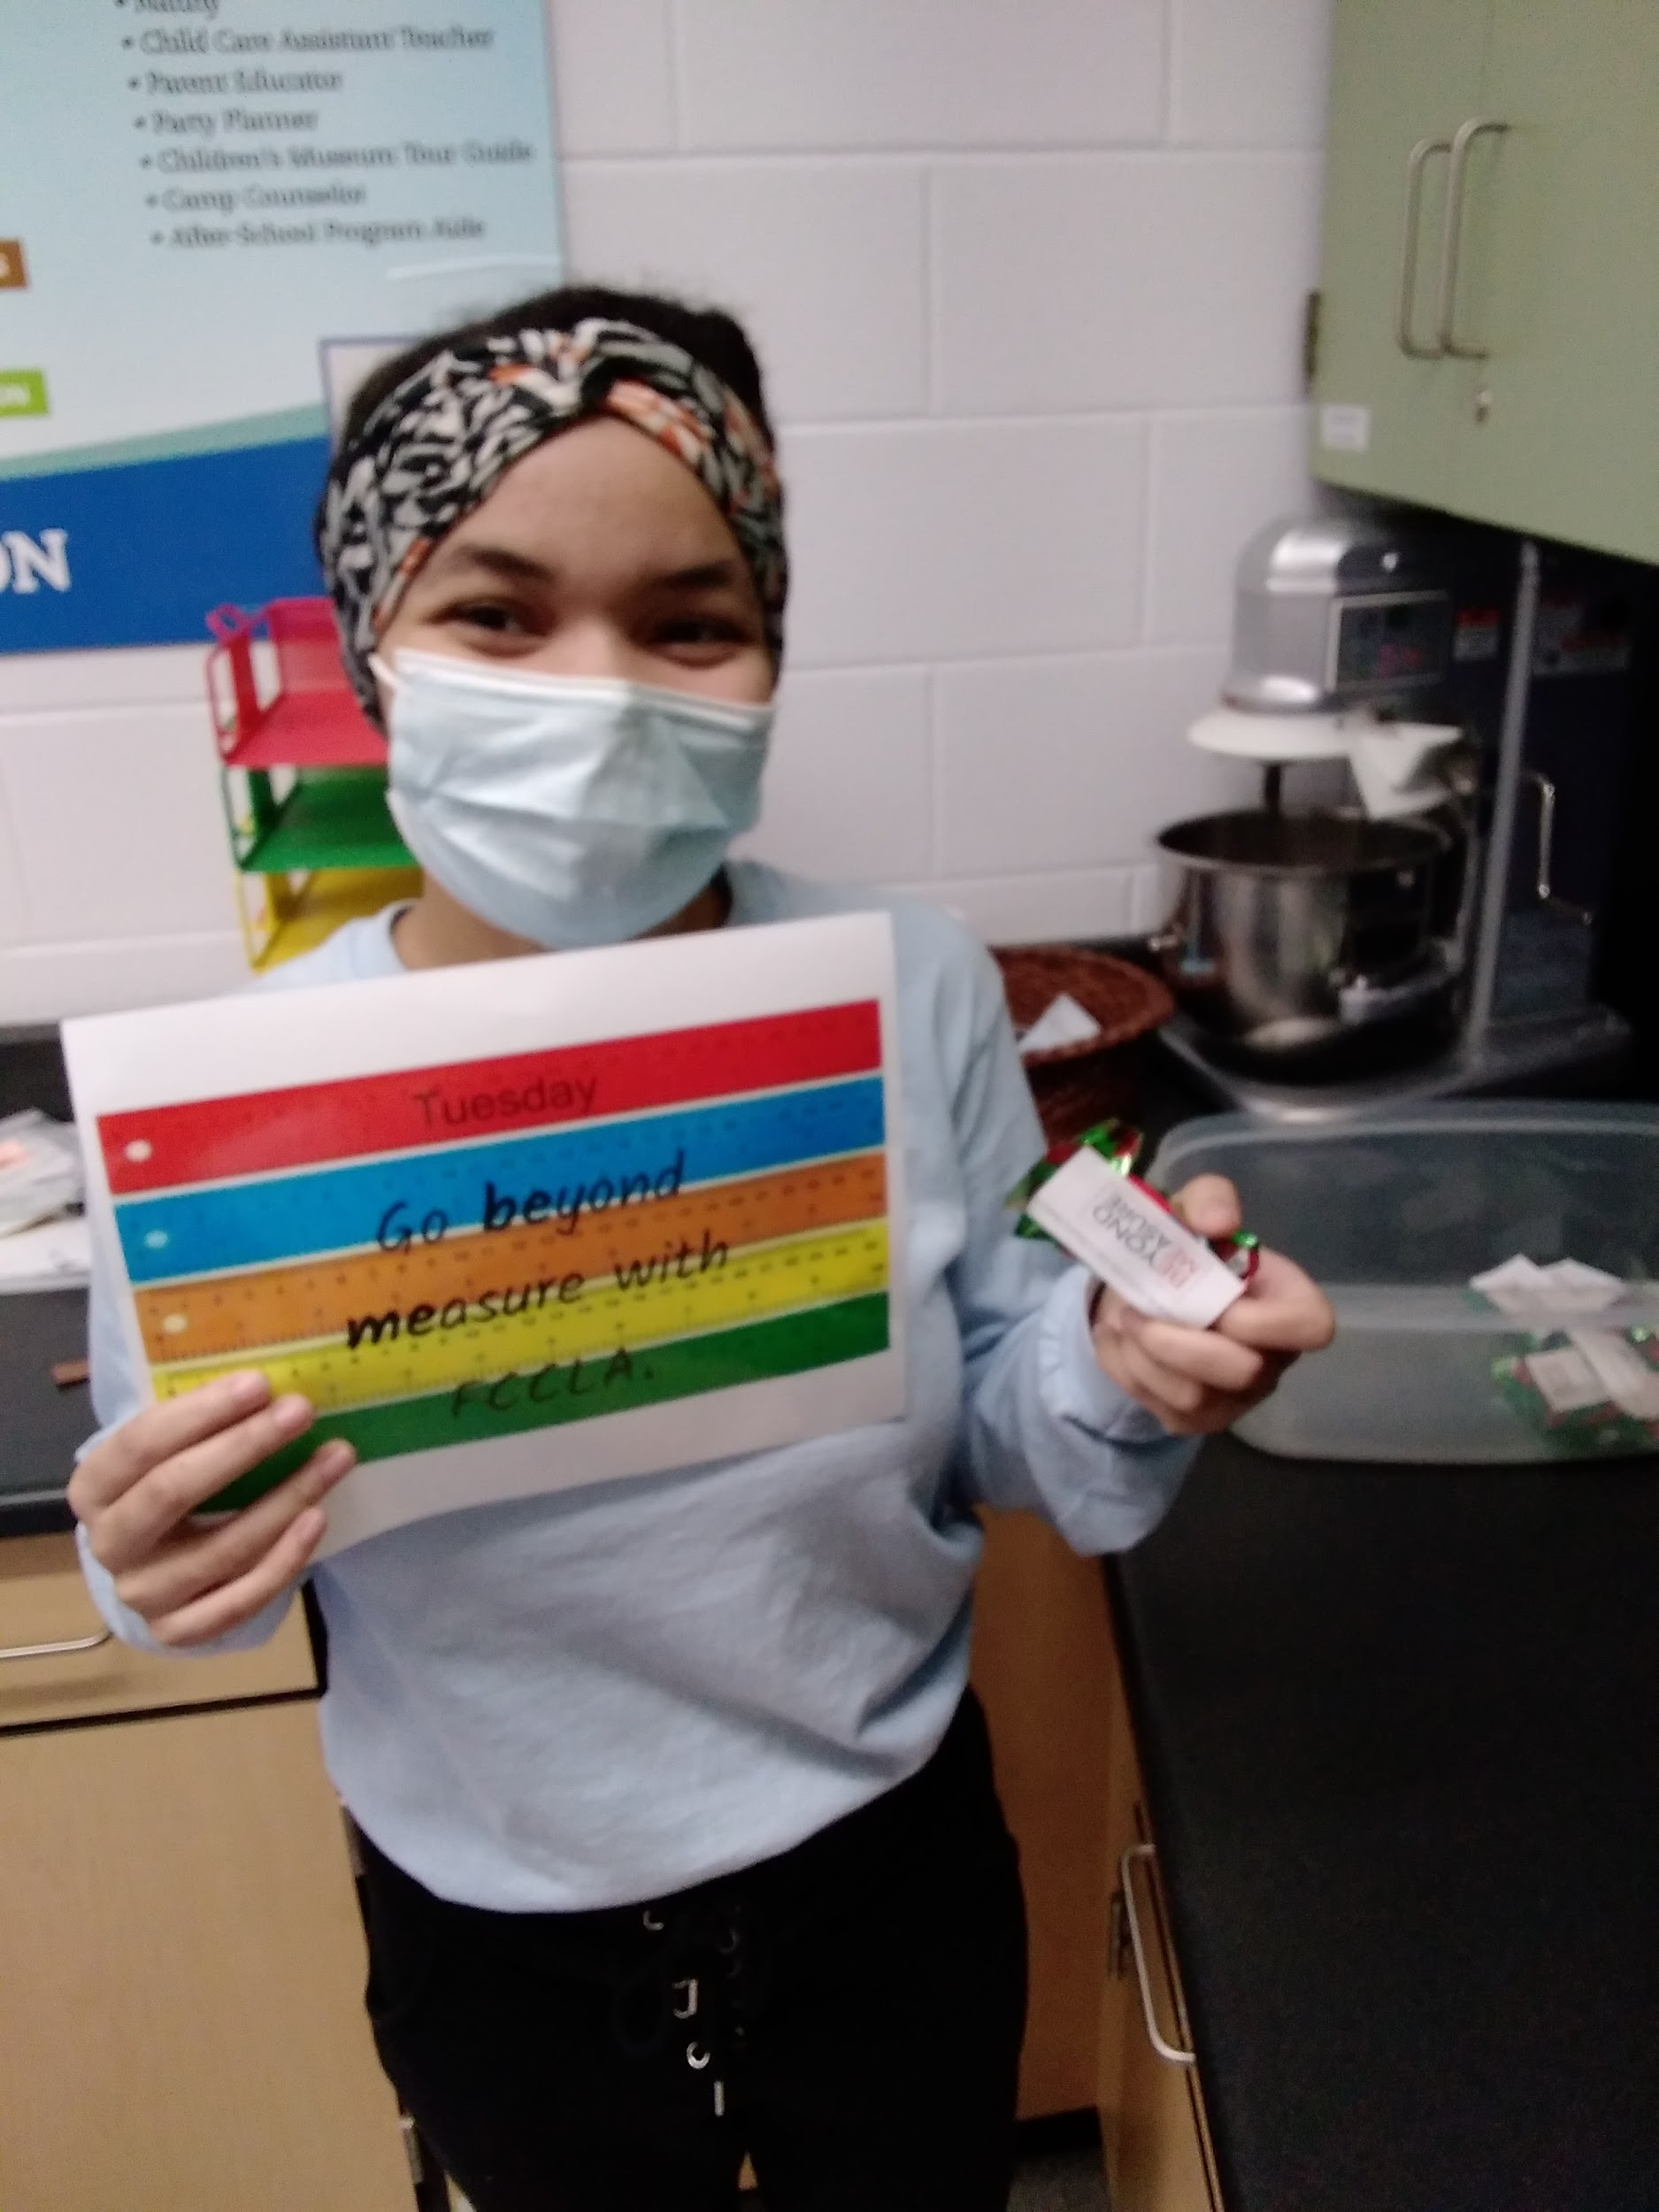
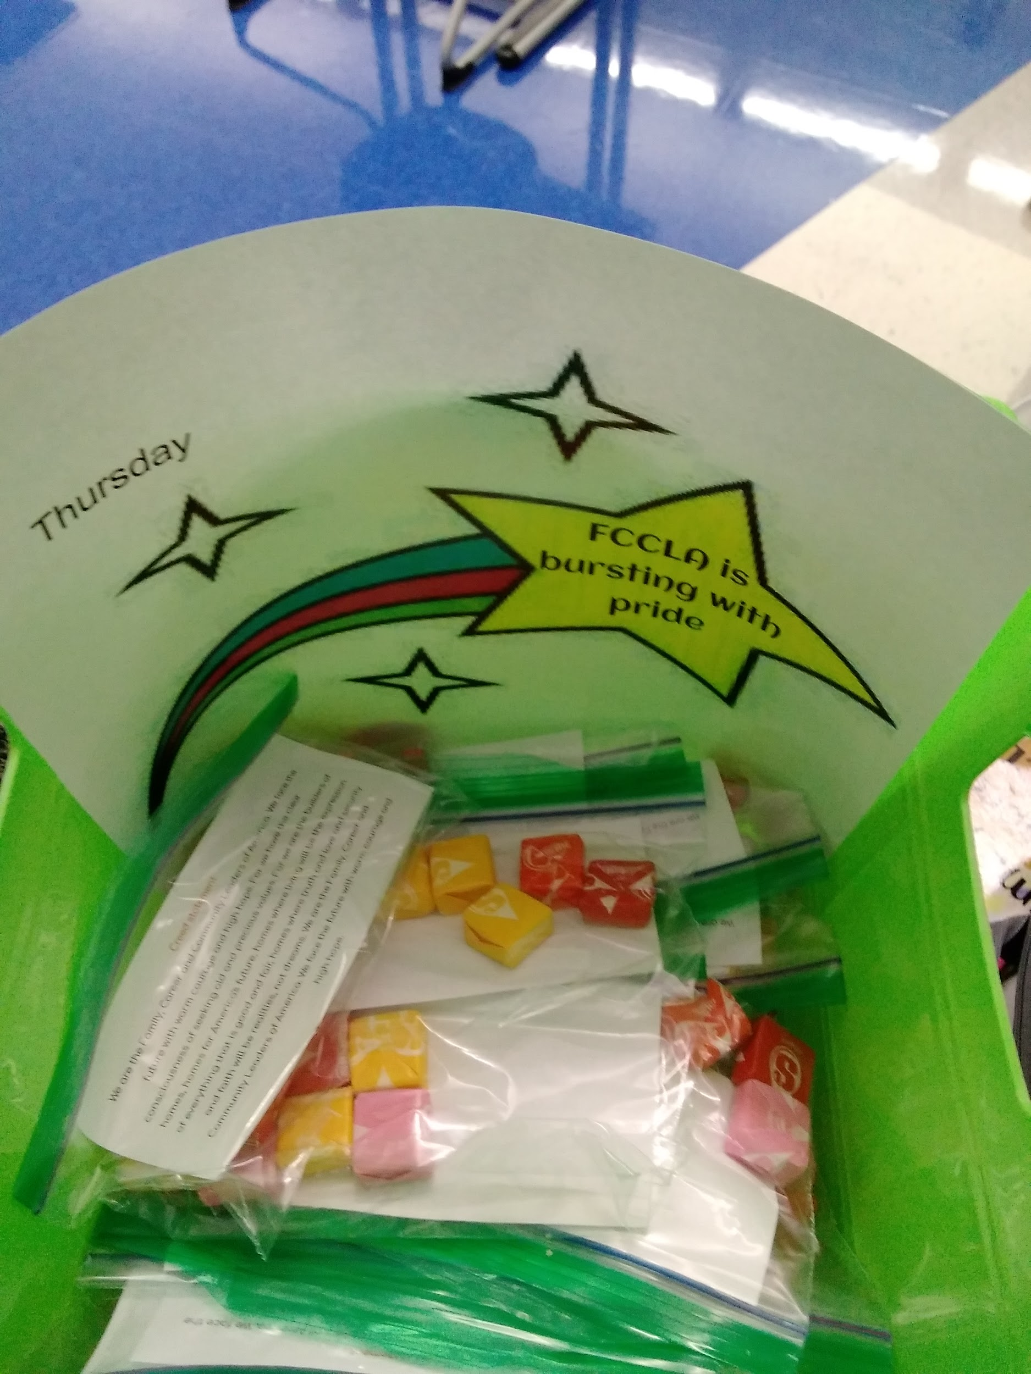
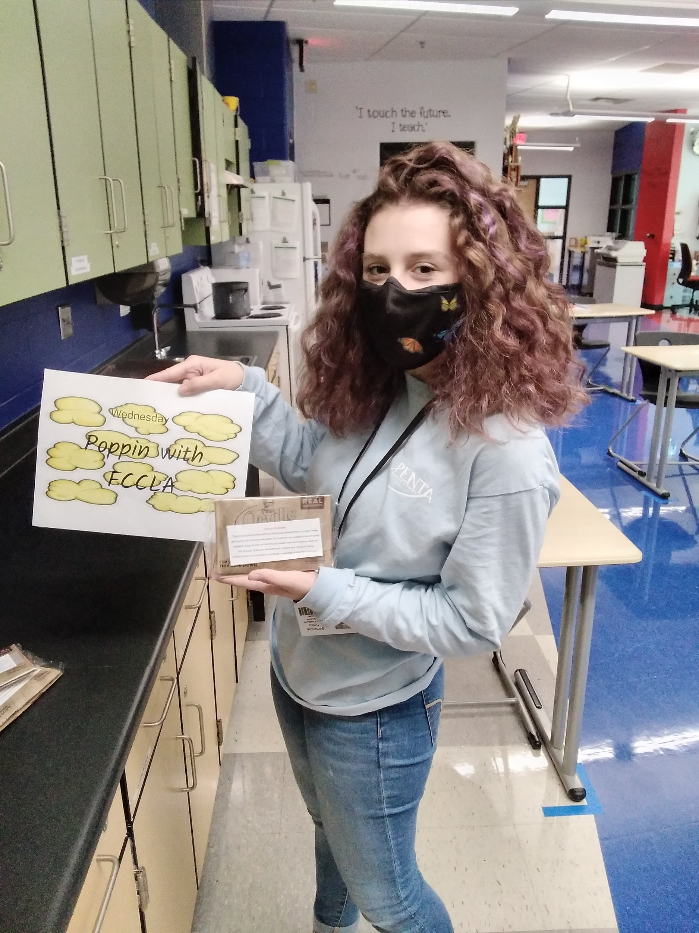
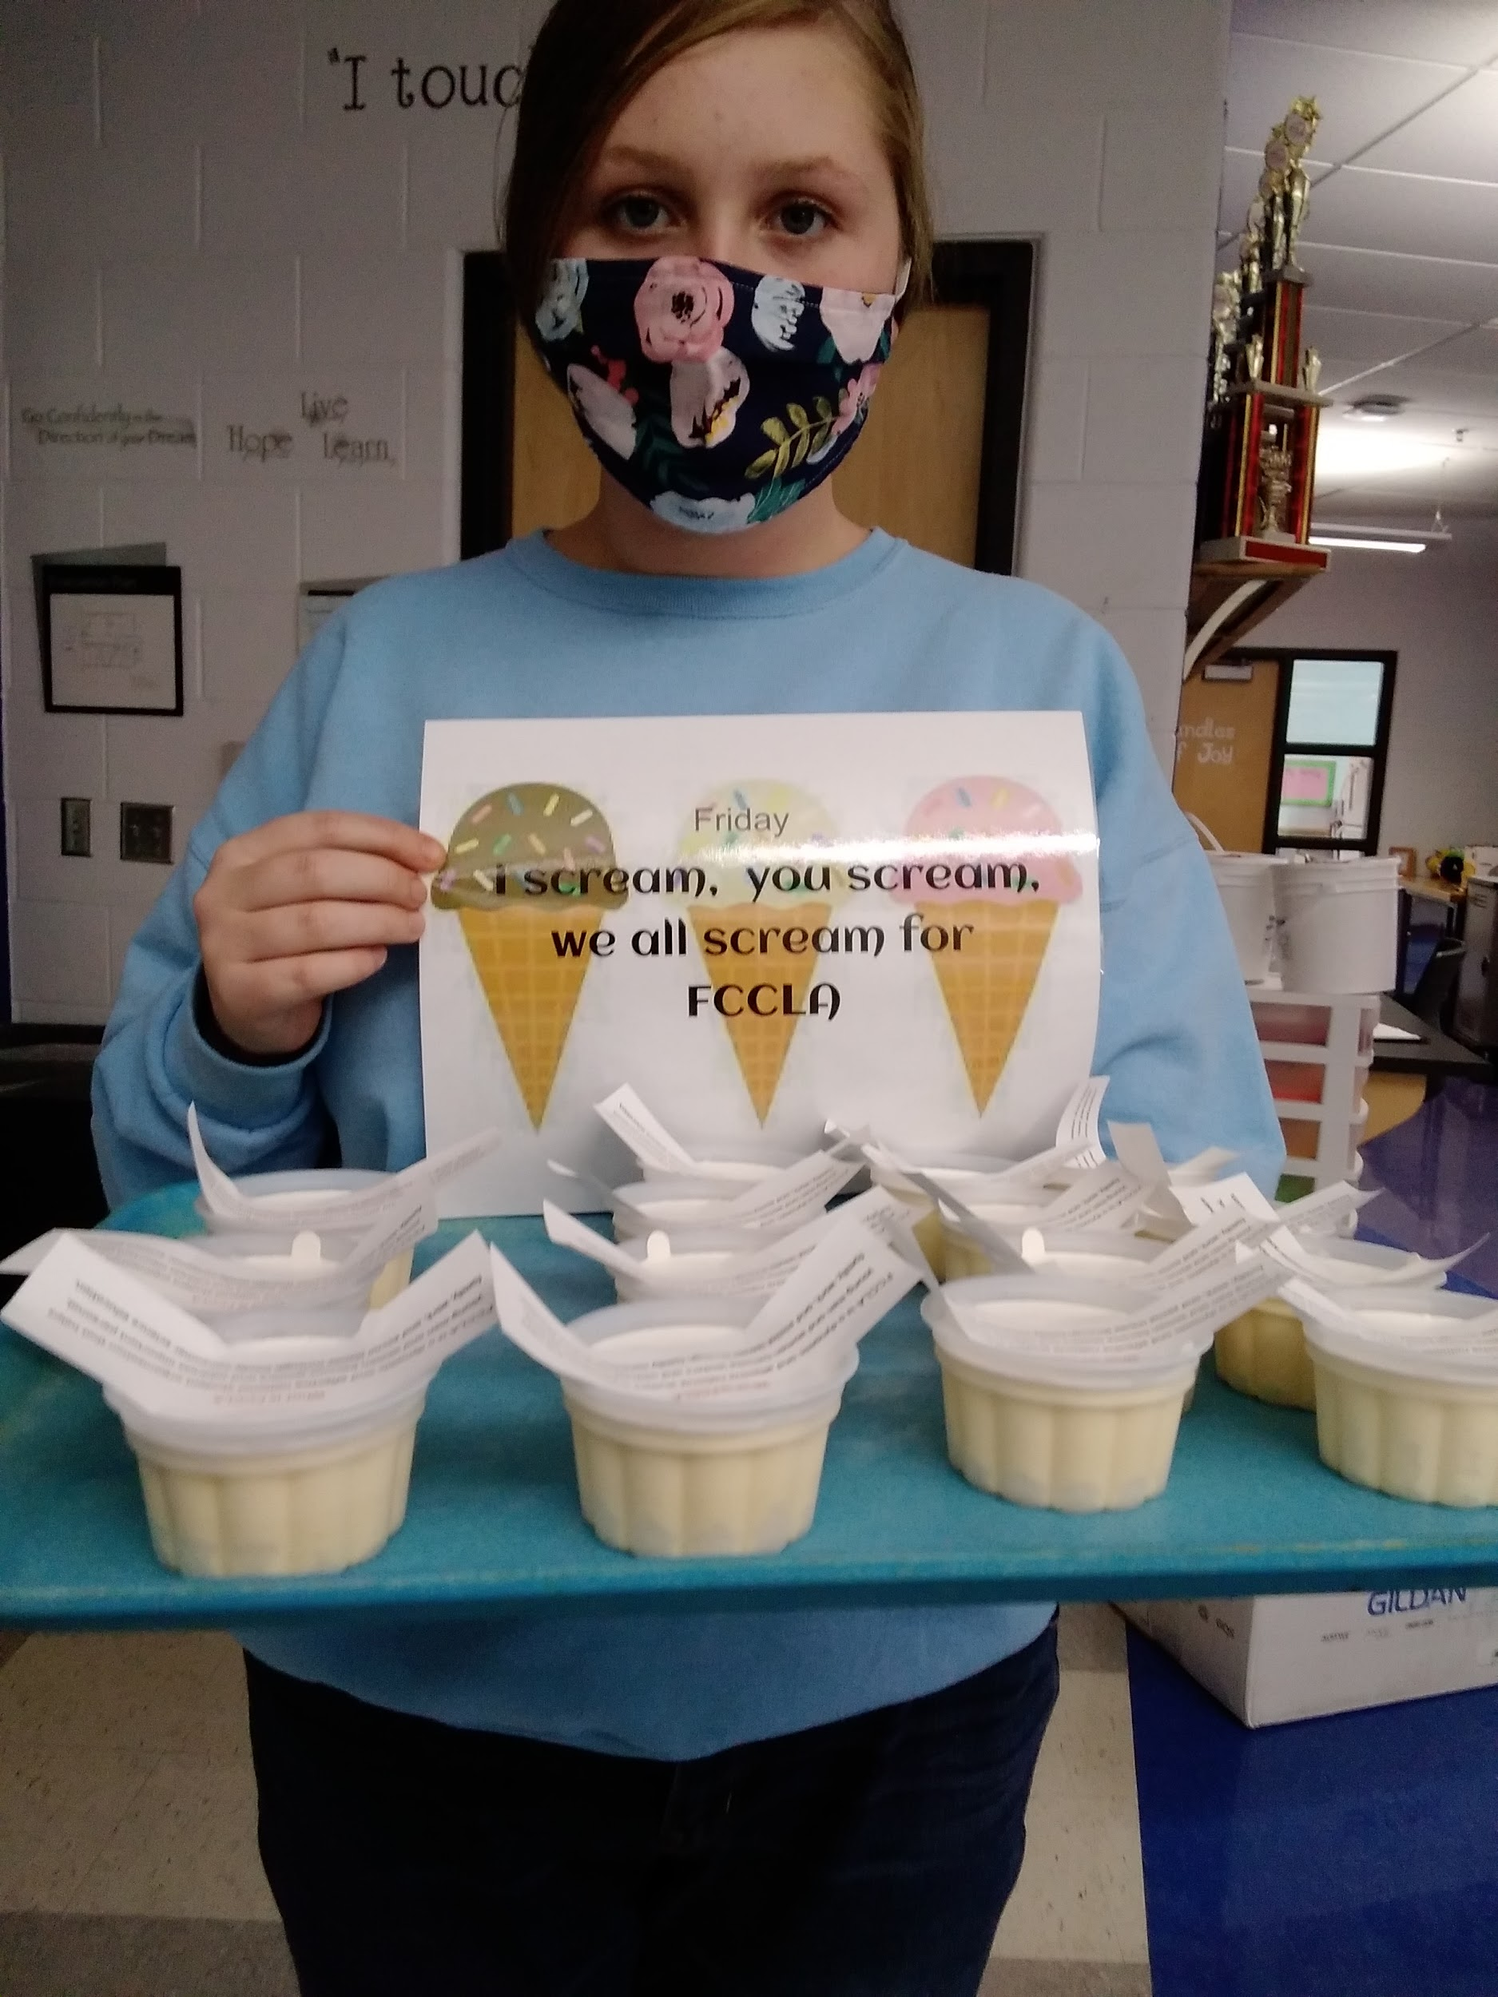
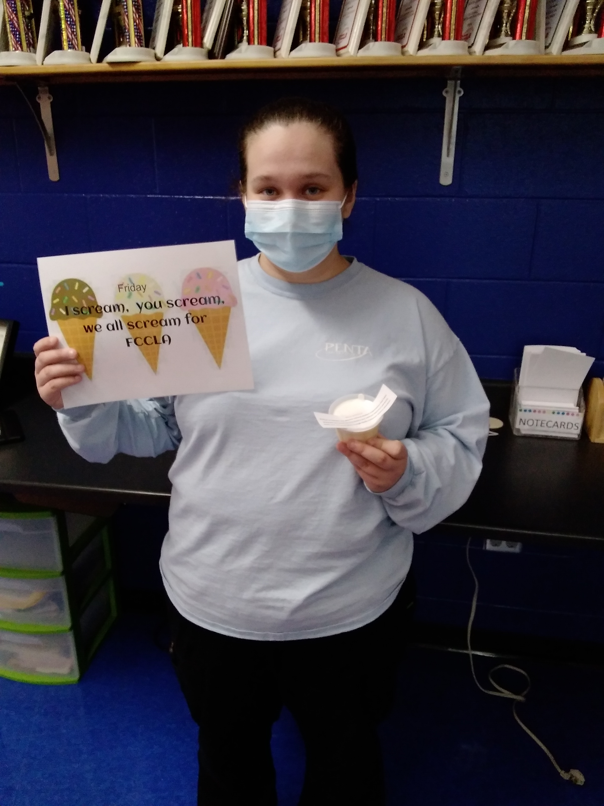
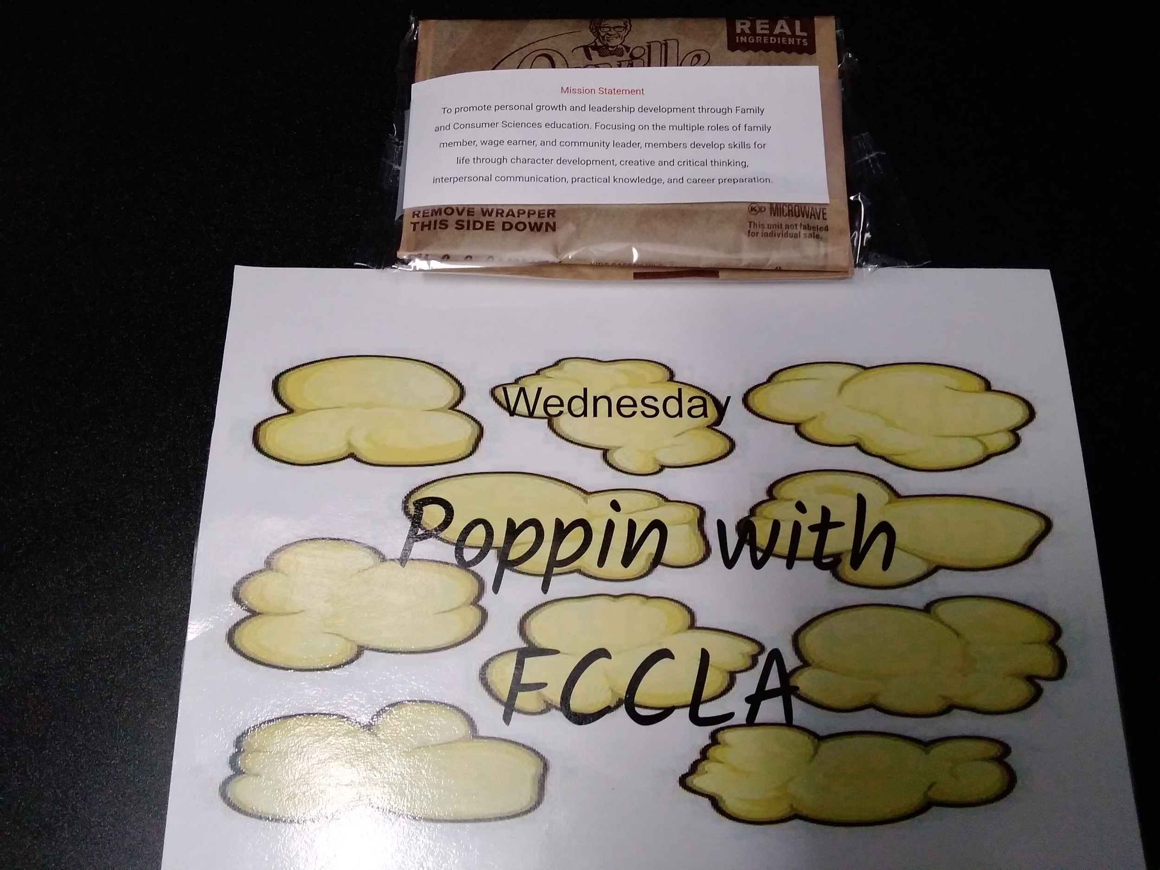
FCCLA Week
Tuesday: Go Beyond Measure
(Fruit by the Foot)
Thursday: Bursting with pride for FCCLA (Starbursts)
Wednesday: Poppin with FCCLA
(Bag of Popcorn)
Friday: I Scream, You Scream, We All Scream for FCCLA (Ice Cream)

Slide 19
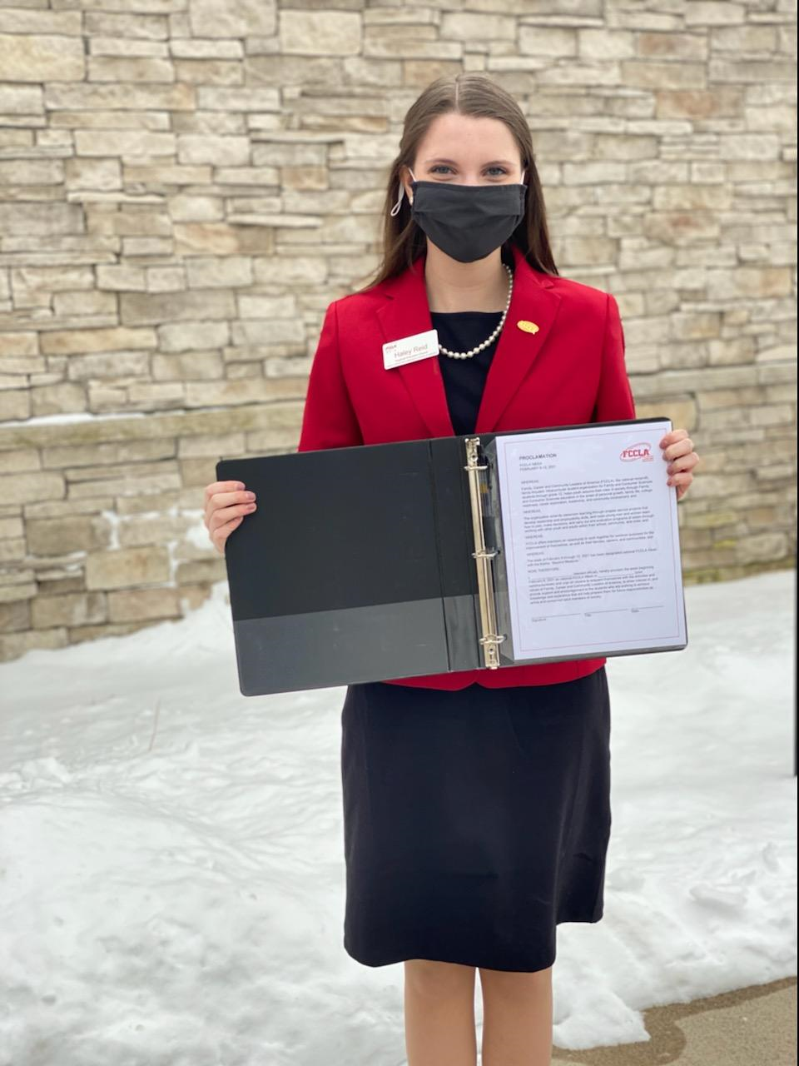
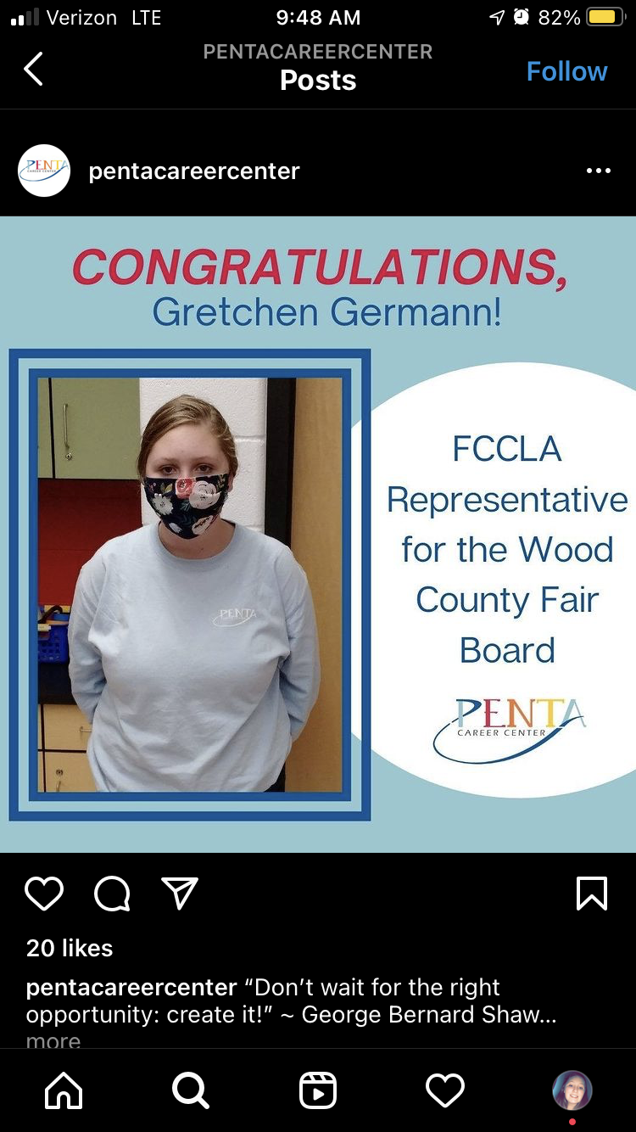
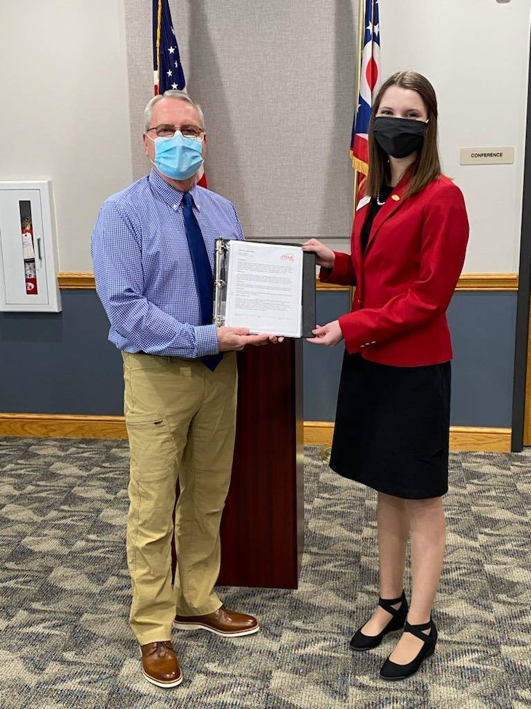
Recognition Of FCCLA Members
Gretchen Germann receiving acknowledgement on her Wood County Fair Board Position through Penta Career Center’s Facebook page.
Haley Reid Penta Satellite student (Ohio Regional Officer) receiving Proclamation for FCCLA Week.

Slide 20
Evidence of Technology Used

Slide 21
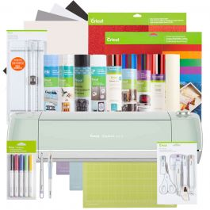
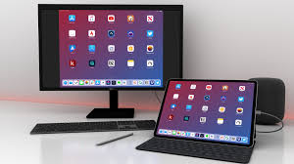
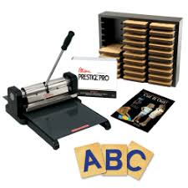
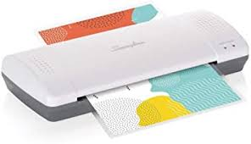
Evidence Of Technology Used
Computer and iPad
Cricut Machine
Laminator
Ellison Machine

Slide 22
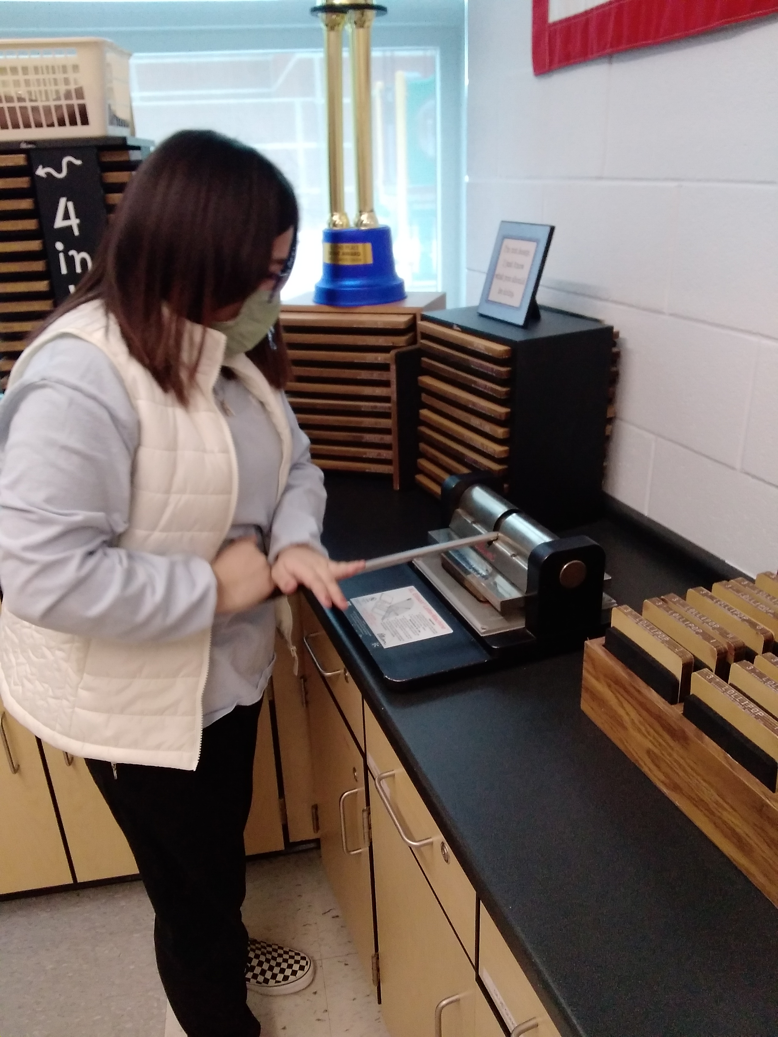
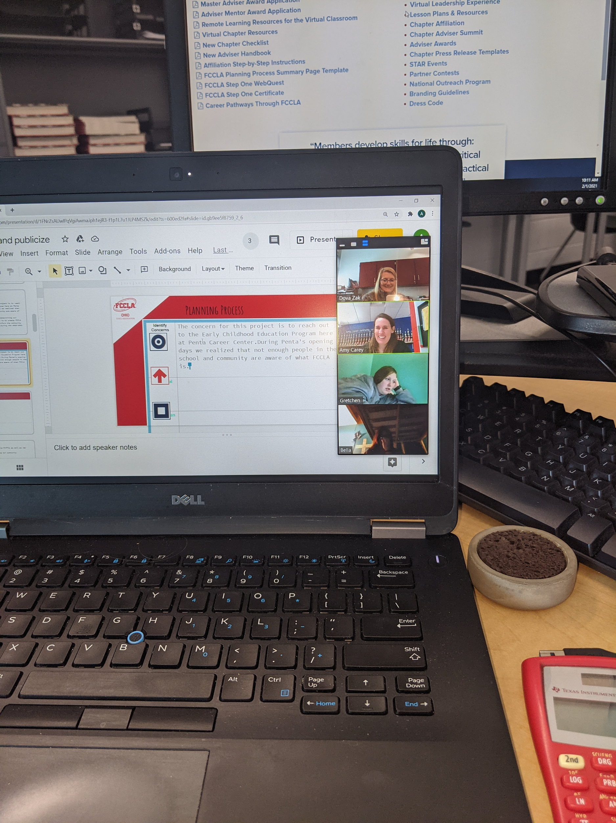
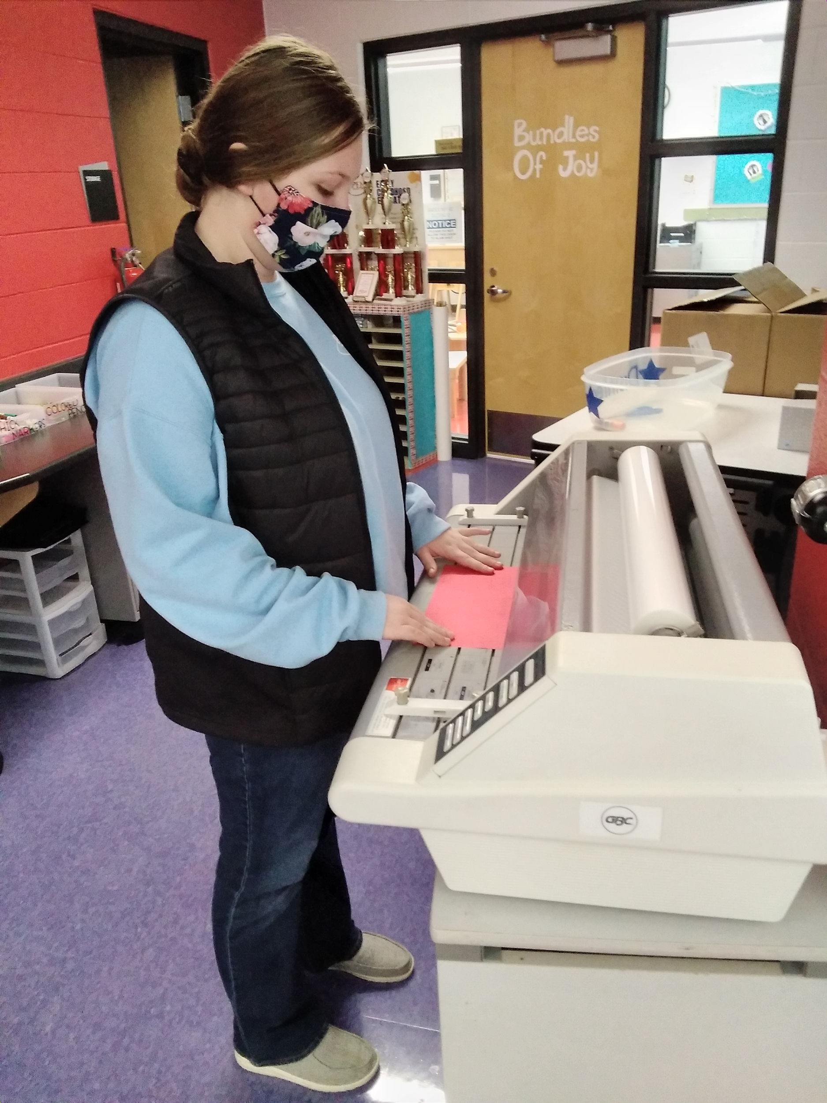
Evidence Of Technology Used
We used the computers and ipads to develop a bitmoji classroom, takes pictures, create items for FCCLA activities and attend Zoom meetings.
We used the cricut machines to design the items to put on our masks.
We used the laminator to laminate our promotional and FCCLA week materials.
We used the Elison machine to create FCCLA promotional activities.

Slide 23
Evidence of Public Awareness and Promotion

Slide 24
Wood County Fair Board FCCLA Representative
1st FCCLA representative in over 17 years appointed to the Wood County Fair Board!!

Slide 25
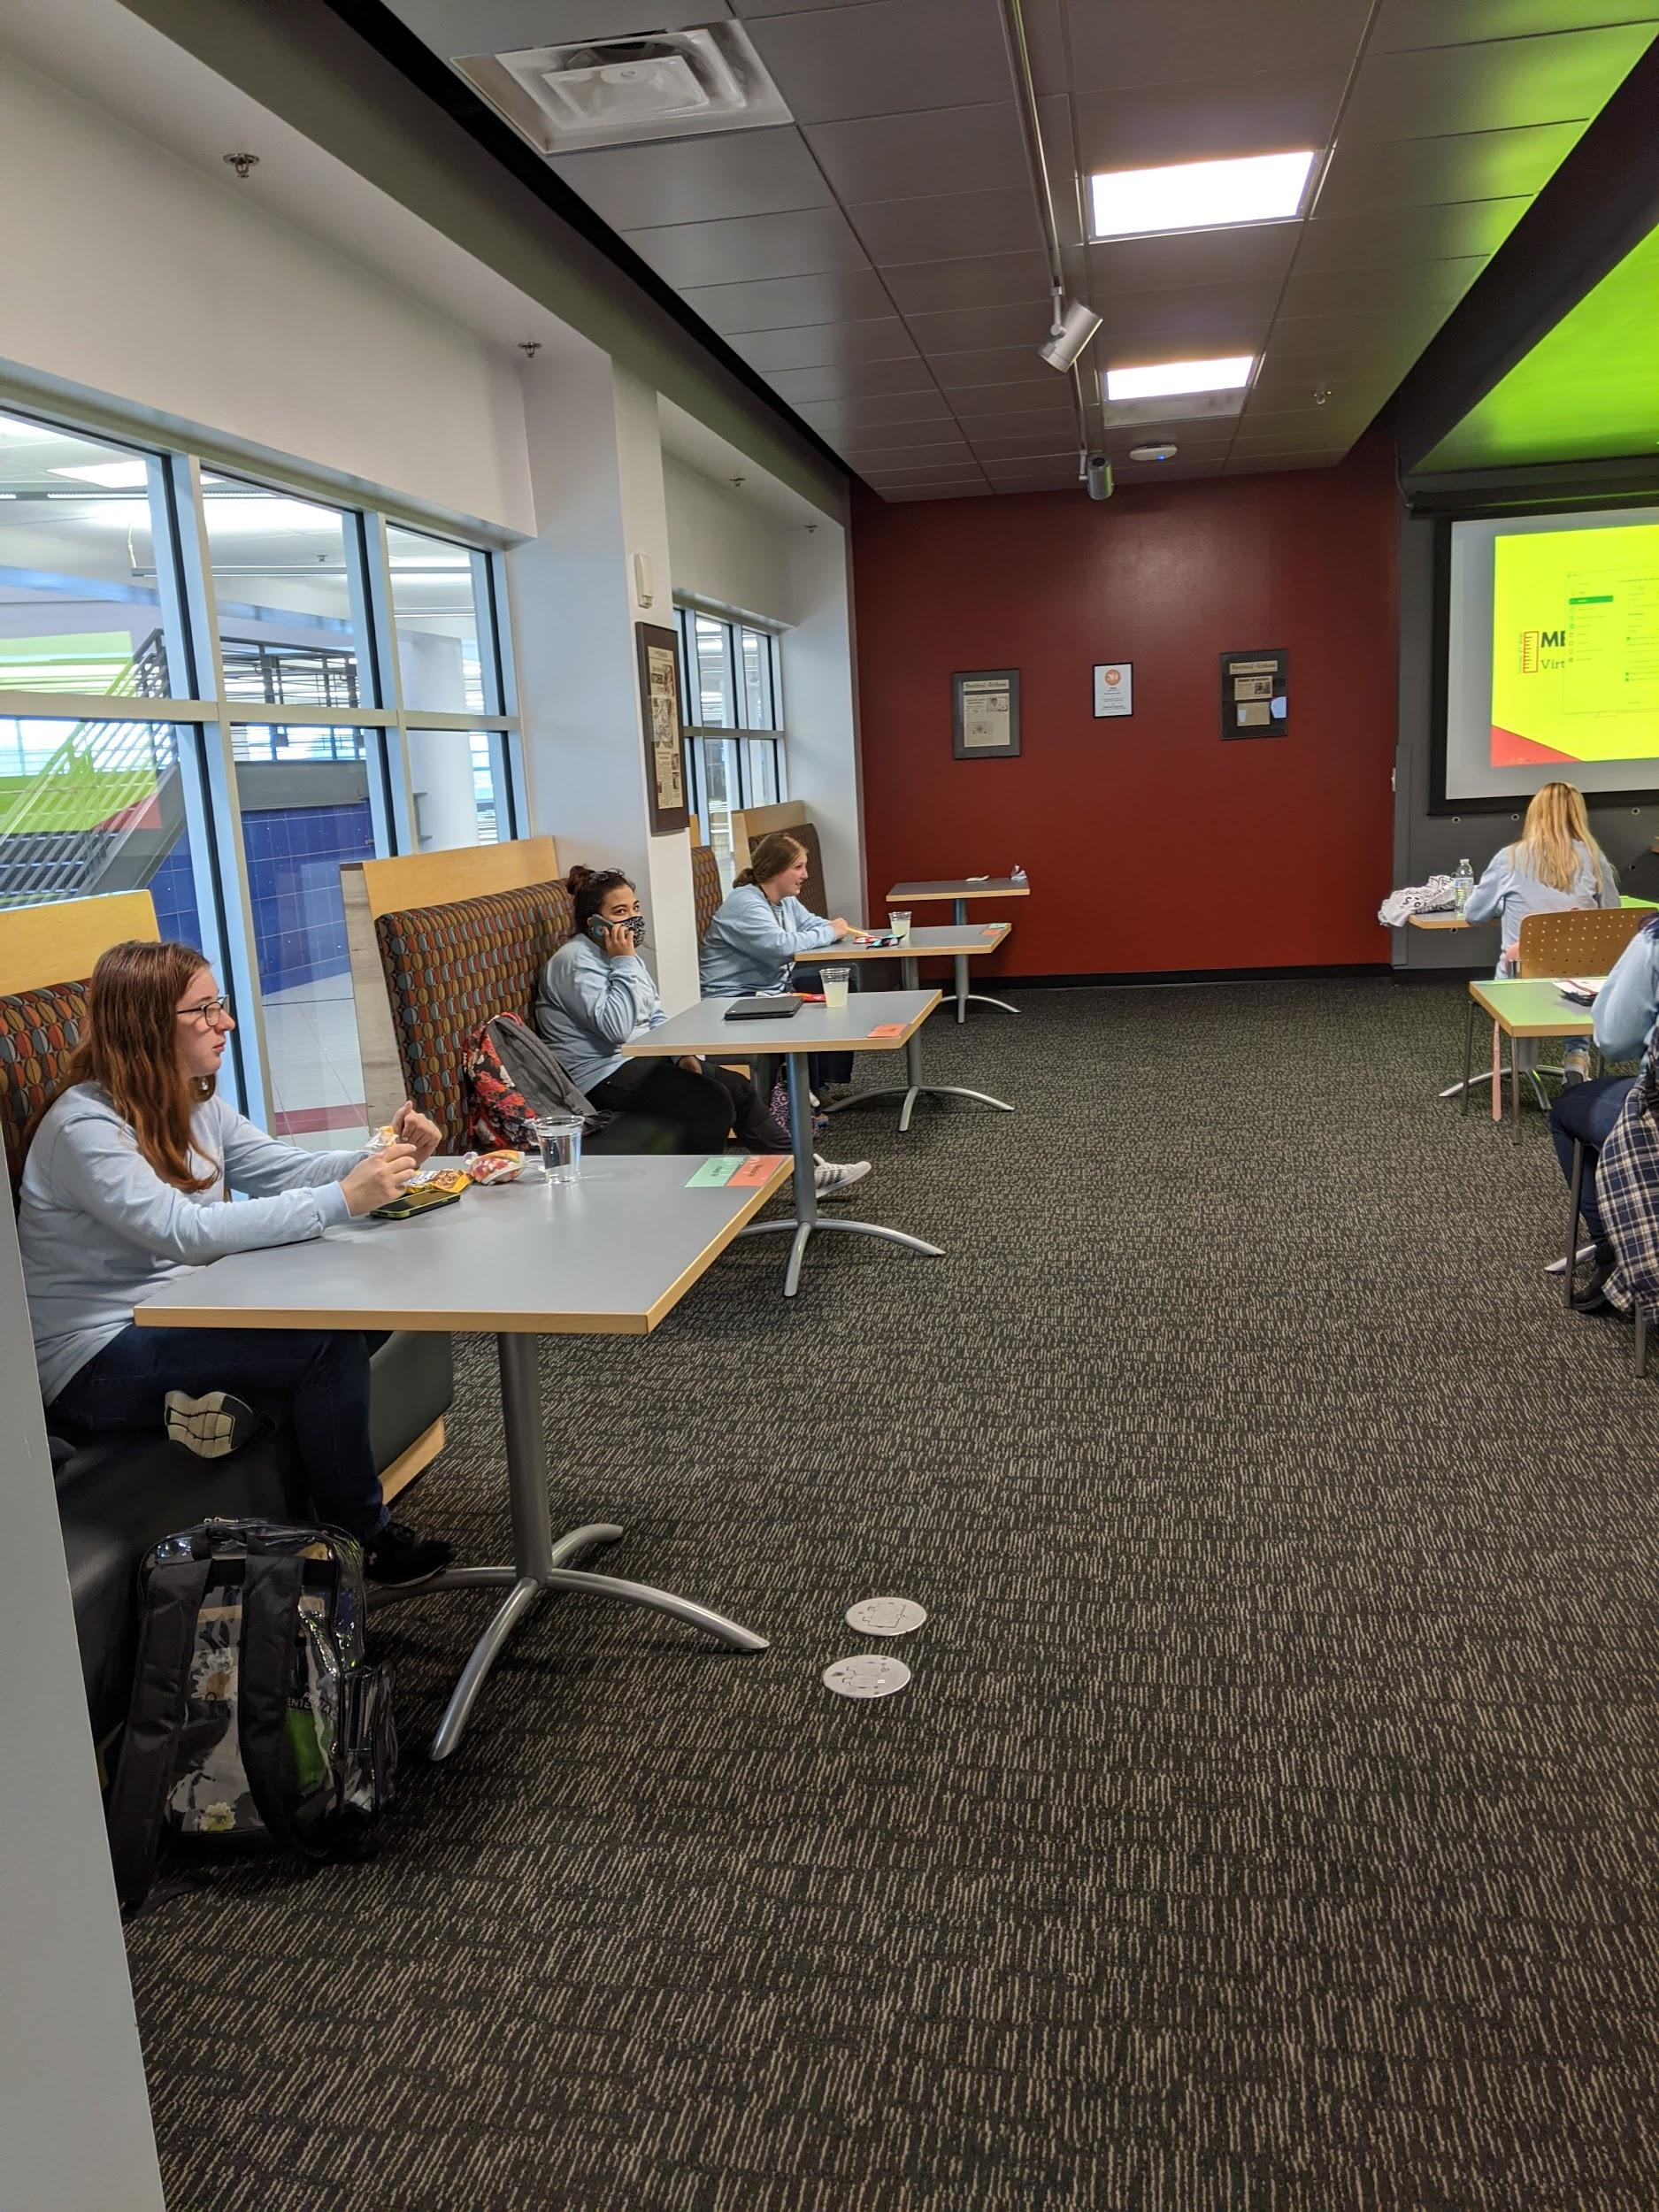
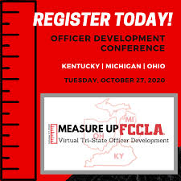
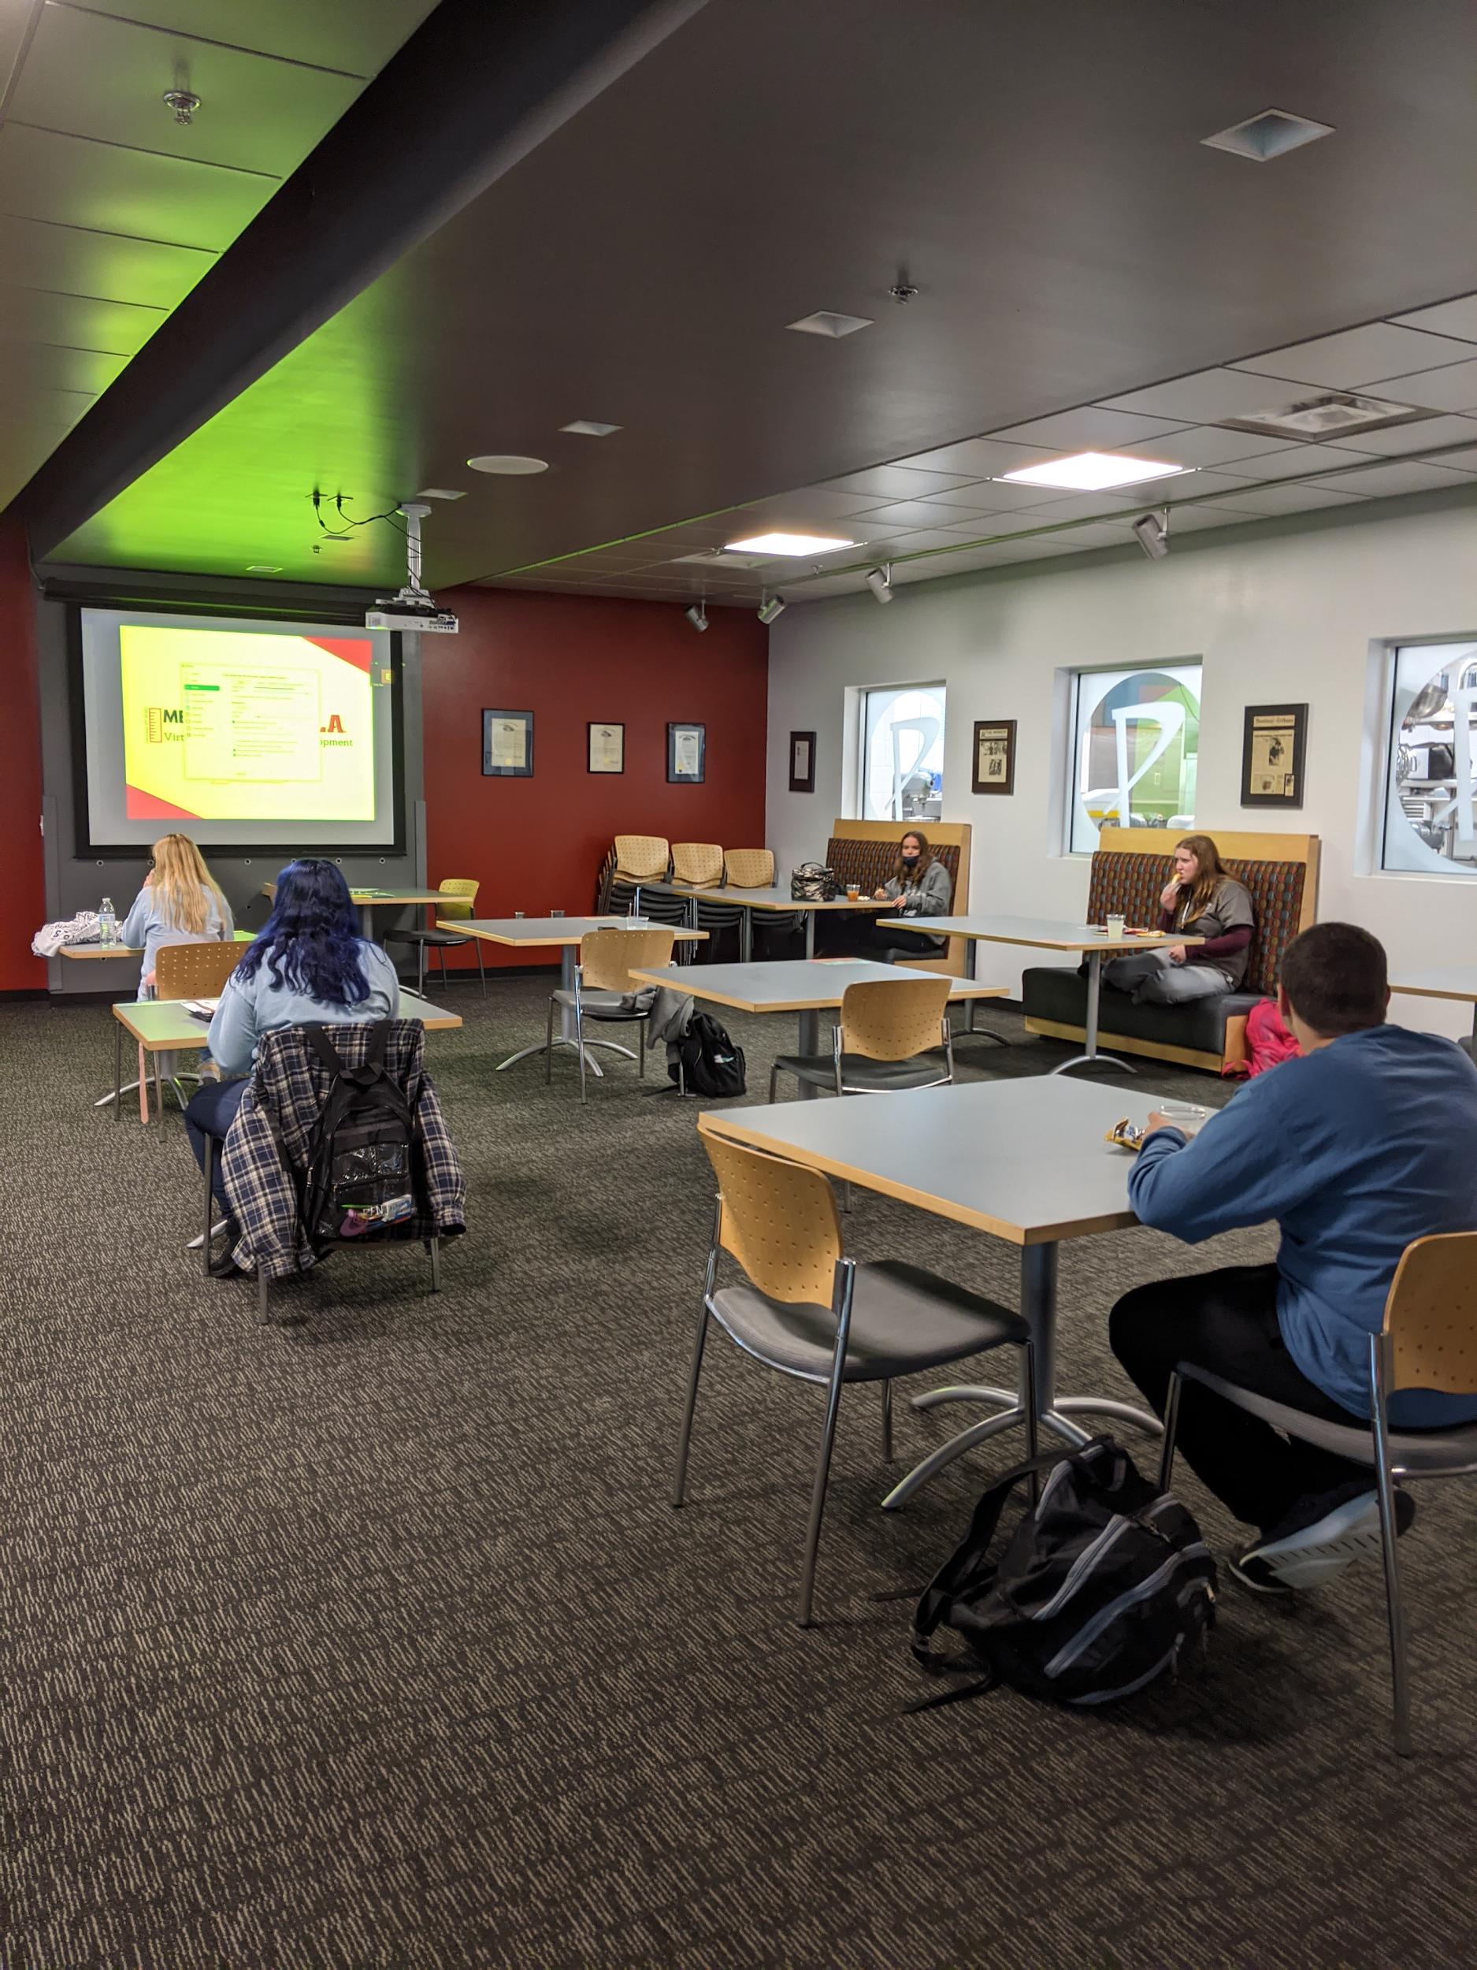
Tri- State Leadership Confrence

Slide 26
Relationship to Family and Consumer Sciences/Career Fields

Slide 27
Relationship to Family and Consumer Sciences
Within our event career tech program our lab has given us the opportunity to work within the classroom as well as outside the classroom on FCCLA.
The Early Childhood Education lab allows us to participate in FCCLA leadership opportunities and workshops. These included FCS content and focus areas such as team building, problem solving, healthy and unhealthy relationships, as well as the child development topics.

Slide 28
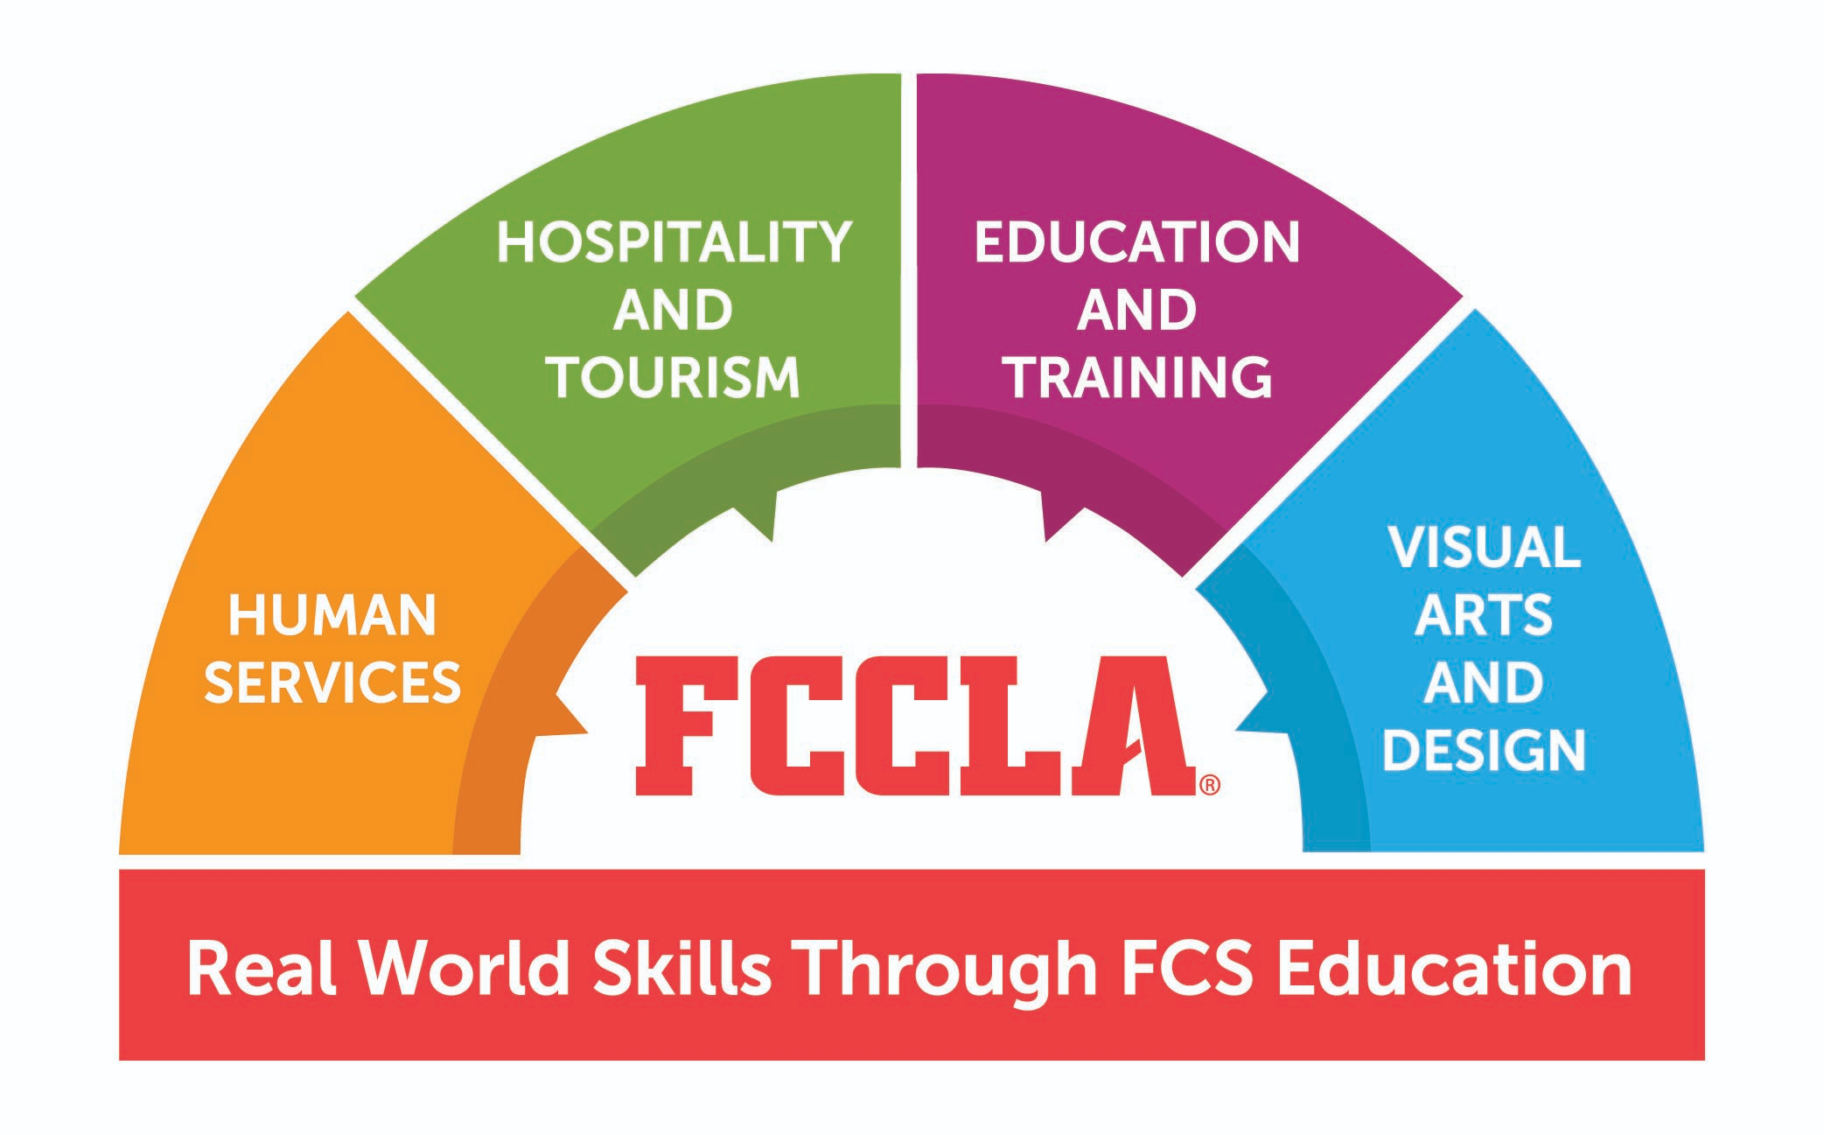
Relationship to Ohio Family and Consumer Sciences
Outcome 1.1. Employability Skills
Develop career awareness and employability skills (e.g., face-to-face, online) needed for gaining and maintaining employment in diverse business settings.
Outcome 1.2. Leadership and Communications
Process, maintain, evaluate and disseminate information in a business. Develop leadership and team building to promote collaboration.
Outcome 1.4. Knowledge Management and Information Technology
Demonstrate current and emerging strategies and technologies used to collect, analyze, record and share information in business operations.
Outcome 1.5. Global Environment
Evaluate how beliefs, values, attitudes and behaviors influence organizational strategies and goals
Outcome 1.8. Operations Management
Plan, organize and monitor an organization or department to maximize contribution to organizational goals and objectives.

Slide 29
Relationship to National Family and Consumer Sciences
1.1 Analyze strategies to manage multiple roles and responsibilities (individual, family, career, community, and global).
1.2 Demonstrate transferable knowledge, attitudes, and technical and employability skills in school, community and workplace settings.
1.3 Evaluate the reciprocal effects of individual and family participation in community and civic activities.

Slide 30
Work Cited

Slide 31
Works Cited
“About.” FCCLA, 2021, fcclainc.org/about.
“Education and Training.” Ohio Department of Education, education.ohio.gov/Topics/Career-Tech/Education-and-Training-Career-Field.
“History.” FCCLA, fcclainc.org/about/history.
“Home.” Ohio FCCLA, 29 May 2020, www.ohiofccla.org/.
“Mission & Purposes.” FCCLA, 4 Jan. 2018, mnfccla.org/about/who-we-are/mission/.
“National Standards.” Home, www.leadfcsed.org/national-standards.html.
**MLA Format**

